Slide 1

LABORATORY SAFETY AND CHEMICAL WASTE MANAGEMENT
Prof. Dr. Sena Yaşyerli, Prof. Dr. Ayla Altınten, Research Asist. Dr. Dolunay Eslek Koyuncu, Lect. Dr. Funda Turgut Başoğlu, Lect. Merve Gördesel

Slide 2
PURPOSE
Security program includes your responsibilities for your health and safety and of your environment

Slide 3
CONTENT
Working in the laboratory
Being aware of the dangers
Things to do in case of accident

Slide 4
Working in the Laboratory
☑ Being careful
☑ Using personal protection equipment
☑ Following general rules
☑ Having prior knowledge about the experiment

Slide 5
General rules
In the Laboratory,
Do not work in the laboratories alone and without the knowledge of the laboratory staff.
Personal protective equipment (PPE) should be used while working in the laboratory.

Slide 6
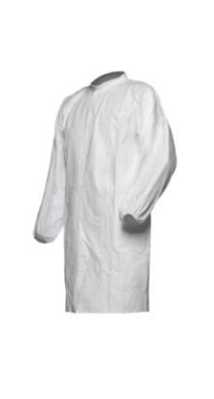


Personal Protective Equipment (PPE)
Necessary equipment at minimum conditions :
Safety glasses, long lab coat, gloves
It should be worked in the lab with a long lab coat and its front should be kept attached.
Gloves (preferably nitrile) and safety glasses should be worn when working in the laboratory.

Slide 7


General rules
In the Laboratory,
Do not work in laboratories alone and without
the knowledge of the laboratory staff.
Personal protection equipment should be used
while working in the laboratory.
Shoes should be closed and suitable for working in the laboratory; It should not be entered with muddy or dusty shoes to the laboratory.
Long-haired students cannot enter the laboratory without making ponytail.
Working with items such as rings, necklaces, bracelets in the laboratory can be dangerous. Take off them before starting work.
Do not enter with a contact lens.
Turn off your mobile phones.

Slide 8
Complete your preliminary research on your experiment.
Obtain “Material Safety Data Sheet” (MSDS) information about the chemicals you will use in your experiment.
(http://www.jtbaker.com/asp/Catalog.asp)

Slide 9
“Material Safety Data Sheet” (MSDS)
Material Identification
Ingredients and Hazards
Physical Data
Fire and Explosion Data
Reactivity Data
Health Hazard Information
Spill, Leak and Disposal Procedures
Special Protection Information
Special Precaution and Comments

Slide 10
In the laboratory;
DO NOT Hurry.
Do not run and avoid sudden movements.
There must be a good harmony among laboratory group of your friends.
No smoking, no food or drink.
Do not put food and beverages in the refrigerator in the laboratory.
When carrying chemical containers and desiccators, two hands should be used. Hold the lid firmly with one hand while at the same time, the bottom of the container should be supported by the other hand.
Do not leave the drawers, gas stoves and taps you use open.
Do not sit on work benches.
When you need to leave the laboratory during the experiment, take out your PPE and wash your hands.

Slide 11
ALWAYS add acid to water, NEVER add water to acid.
Use the pipettes with the help of "puar".
Water
Acid

Slide 12
Carefully read the labels of the chemicals you use.
Leave the bottles of the chemicals you use by closing the cover.
Do not change where chemicals are.
Do not heat or mix chemicals for trial purposes without the knowledge of the relevant instructor.
Do not mix acids and solvents.

Slide 13
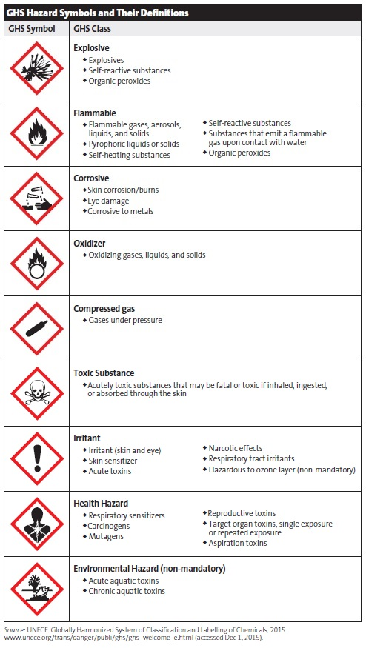
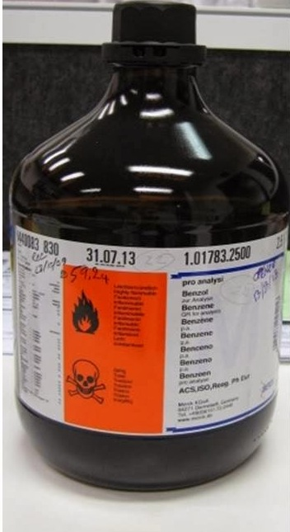
Hazard symbols

Slide 14
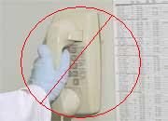
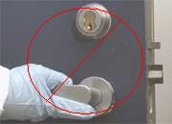
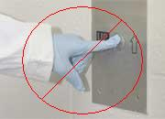
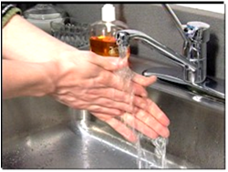
When you leave the laboratory,
Do your checks on your experiment.
Do not use your personal protection equipment outside the laboratory.
Always wash your hands.

Slide 15
Awareness of the Hazards
When you are doing dangerous and potentially hazardous experiments, ask yourself the following questions :
- What is the danger for the experiment ?
- What is the worst thing that could be wrong?
- How can I deal with danger?
- Do I have experience and equipment required to minimize the risk of danger ?
OBTAIN PRE-INFORMATION REQUIRED TO WORK IN THE LABORATORY

Slide 16

How Toxic Substances Can Get Into Our Body
Respiratory
Absorption
Digestion

Slide 17
It is most important to be calm in any accident.
In case a contact with the chemical, the eyes or skin should
be washed with plenty of water for at least 15 minutes and
shown to the doctor.
In case of fire (if it can be done),
If working with the device, the power plug must be unplugged
If working with gas, the gas line is closed.
Accidents that occur are reported to the Laboratory Staff and
the relevant Faculty Member.
☑ Fire extinguishers,
☑ Safety showers
☑ First-aid kit
☑ Emergency exit
can be used for EMERGENCIES in the laboratory.

Slide 18
CHEMICAL WASTE MANAGEMENT
Rules
Waste containers
Labels
Chemical waste storage
Separation of wastes that are incompatible
with each other

Slide 19
RULES
Chemical wastes should not be mixed with biological or radioactive wastes.
Solid or liquid chemicals should not be mixed with general garbage.
In order to prevent explosion, fire or spills, incompatible chemical combinations should not be mixed in a single container.

Slide 20
WASTE CONTAINERS
All containers used in chemical waste storage must be undamaged.
Liquid waste containers can only be filled to 70-80% of its capacity to allow steam to spread and to minimize potential spills.
The container material is compatible with the chemical waste stored. (For example, hydrofluoric acid should not be stored in a glass container.)

Slide 21
LABELS
All waste containers should be clearly labeled to prevent any unwanted reactions.

Slide 22
STORAGE OF CHEMICAL WASTES
Chemical waste can be temporarily stored in the laboratory.
Waste should be separated according to compatible groups.

Slide 23
WASTE CLASSIFICATION
Acids
Bases
Organic compounds
Solid wastes

Slide 24
SEPERATION OF WASTES THAT DO NOT MATCH WITH EACH OTHER
Group A – Inorganic Acids and Acid Salts
All inorganic acids (eg. sulfuric, hydrochloric)
All compounds that do not release gas when acidified (eg. sodium sulfate)
Inorganic solids that are inert (eg. silica)
Group B – Bases, Caustics and Acid Reacting Compounds
Organic and inorganic bases (eg. pyridine, amines, sodium hydroxide)
Elements that can react with acid and inorganic salts (eg. potassium cyanide, ferric sulfide)

Slide 25
Group C – Neutral Organic Solids
All neutral organic compounds (eg. carbon, styrene)
Group D – Flammable Liquids, Halogenated Solvents and Organic Acids
All organic liquids except organic bases (eg. toluene, chloroform)
Organic acids (eg. formic acid, acetic acid)
Group E – Oxidizers
Igniting inorganic compounds (eg. hydrogen peroxide)

Slide 26
WARNINGS
Never add water on acid.;
  Causes acid splashes that may be dangerous as heat will be released as a result of the reaction.
Glass fractures;
  Should be thrown into the solid waste container.
If mercury thermometer breaks;
  Mercury is very dangerous for human health and can penetrate through the skin.
  In this case, inform the laboratory staff immediately.

Slide 27
Each student is obliged to carry out his experiments in a way that he/she minimizes personal hazards and is aware of potential environmental pollution.
Working safely does not mean that it will protect you from all kinds of dangers.

Slide 28
Material Safety Data Sheet (MSDS)
http://www.jtbaker.com/asp/Catalog.asp
WARNING
All Chemical Eng. Students are expected to come to the experiment by learning about the properties of all chemicals to be used before each experiment.

Slide 29
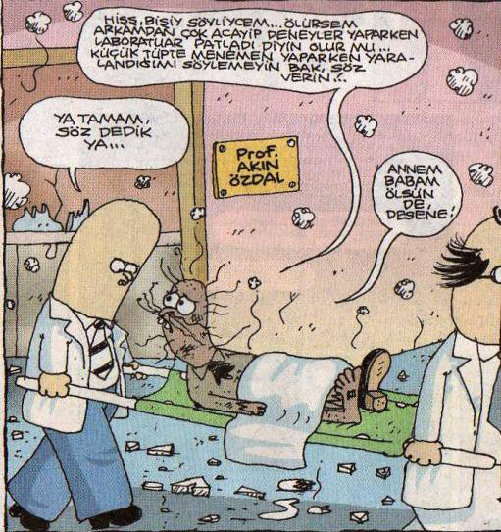
You may not always be so lucky.

Slide 30
References
Turton, R., Bailie, R.C., Whiting W.B., Shaeiwitz J.A., 1998, “Analysis, Synthesis, and Design of Chemical Processes”,Chapter:21, Prentice Hall, New Jersey.
Safety in Academic Chemistry Laboratories” American Chemical Society, 7th, www.acs.chemistry.org
“Handbook of Laboratory Safety” 4th edition, CRC Press, 2000
Jarrell, D, Herrick K., 2001, “Laboratory Training Manual”, Chem. Hygiene Plan Training, V8.0 12, University of Michigan.
www.umich.edu/∼oseh
www.utoronto.ca/safety/chmdisp.htm

Slide 31
TEAM WORK,
REPORT WRITING
AND ETHICS
February, 2020

Slide 32
TEAM WORK
“Chains are only as strong as their weakest link.”
Managers who build a team are more successful,
 It is important to cherish respect for people cooperation,
Using we statement in dialogs, not you and me.
Alone we can do so little, together we can do so much.
 Remuneration leads to team members motivation.
Promoting the right behaviours and thank the team,
 Keep calm in team work and create a pleasant work environment.
Matching of skills with work-sharing.

Slide 33
REPORT WRITING FORMAT
 Abstract
 Table of Content
 List of Table
 List of Figure
 I. Theory
 II. Experimental
 Data sheet
 III. Calculations
 IV. Results and Discussions
 V. Conclusions
 VI. Recommendations
 VII. Index
 VII. References
 Appendix

Slide 34
EVALUATION OF THE REPORT
Abstract %10
Theory %10
Experimental %10
Data-Calculations %25
Results and Discussions %25
Conclusions %10
Overview %10

Slide 35
ETHICS
Members of the American Institute of Chemical Engineers (AIChE) shall uphold and advance the integrity, honor and dignity of the engineering profession by:
Being honest and impartial and serving with fidelity their employers, their clients and the public;
Striving to increase the competence and prestige of the engineering profession;
Using their knowledge and skill for the enhancement of human welfare.

Slide 36
To achieve these goals:
Hold paramount the safety, health and welfare of the public and protect the environment in performance of their professional duties.
Formally advise their employers or clients (and consider further disclosure, if warranted) if they perceive that a consequence of their duties will adversely affect the present or future health or safety of their colleagues or the public.
Accept responsibility for their actions, seek and heed critical review of their work and offer objective criticism of the work of others.
Issue statements or present information only in an objective and truthful manner.
Act in professional matters for each employer or client as faithful agents or trustees, avoiding conflicts of interest and never breaching confidentiality.
Treat fairly and respectfully all colleagues and co-workers, recognizing their unique contributions and capabilities.
Perform professional services only in areas of their competence.
Build their professional reputations on the merits of their services.
Continue their Professional development throughout their careers, and provide opportunities for the Professional development of those under their supervision.
Source: www.aiche.org/about/code-ethics

