Slide 1

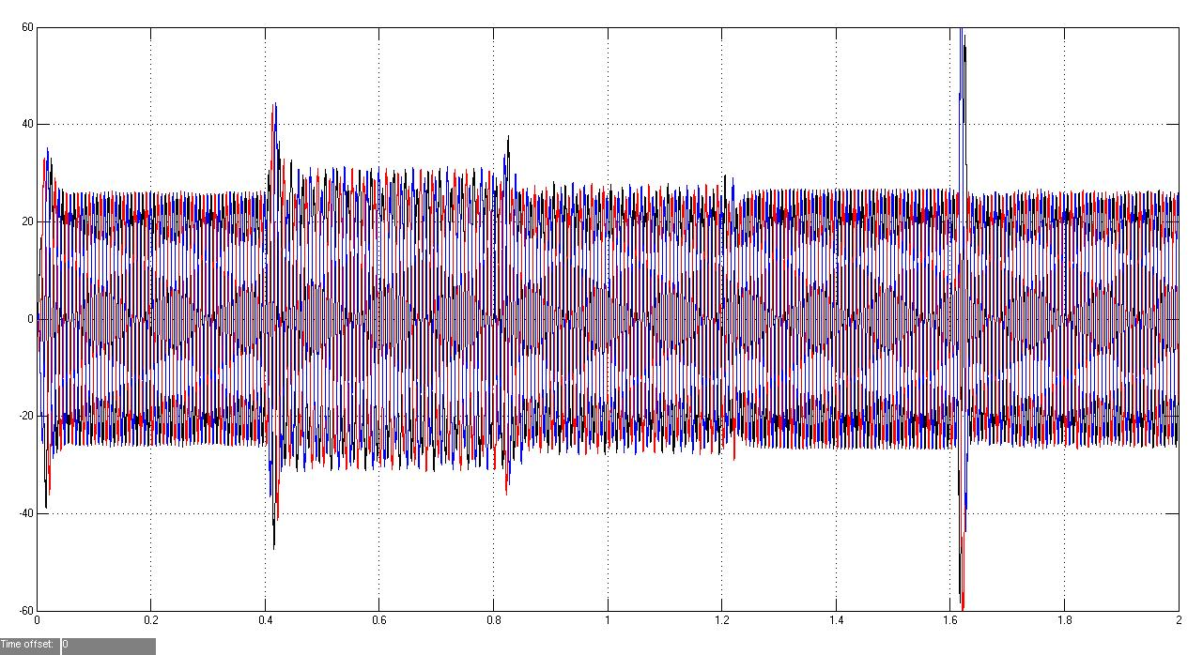
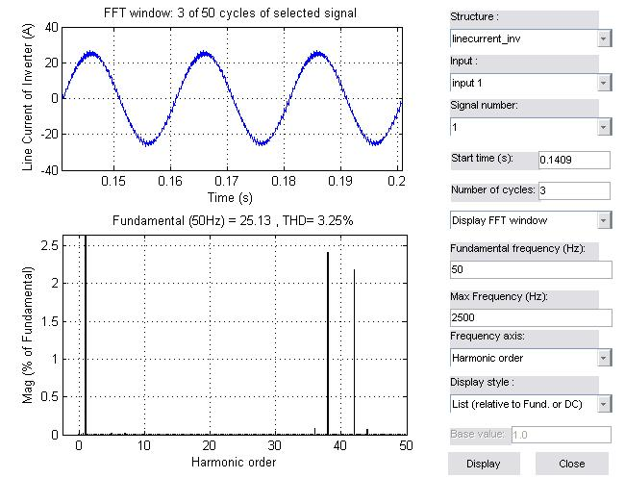
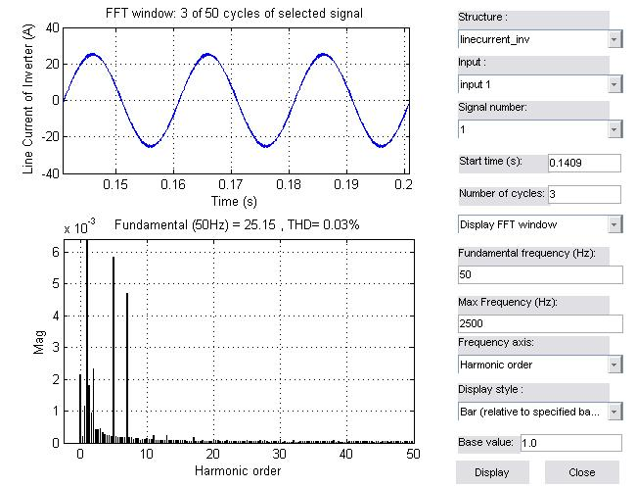
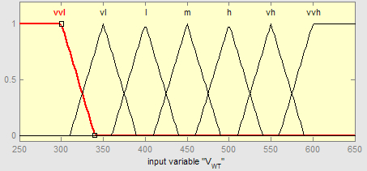
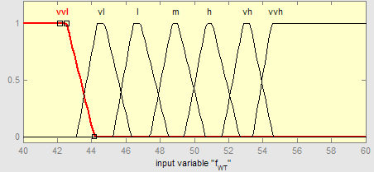
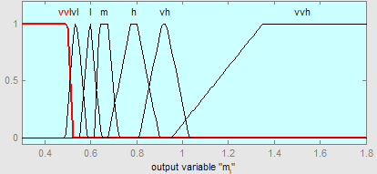
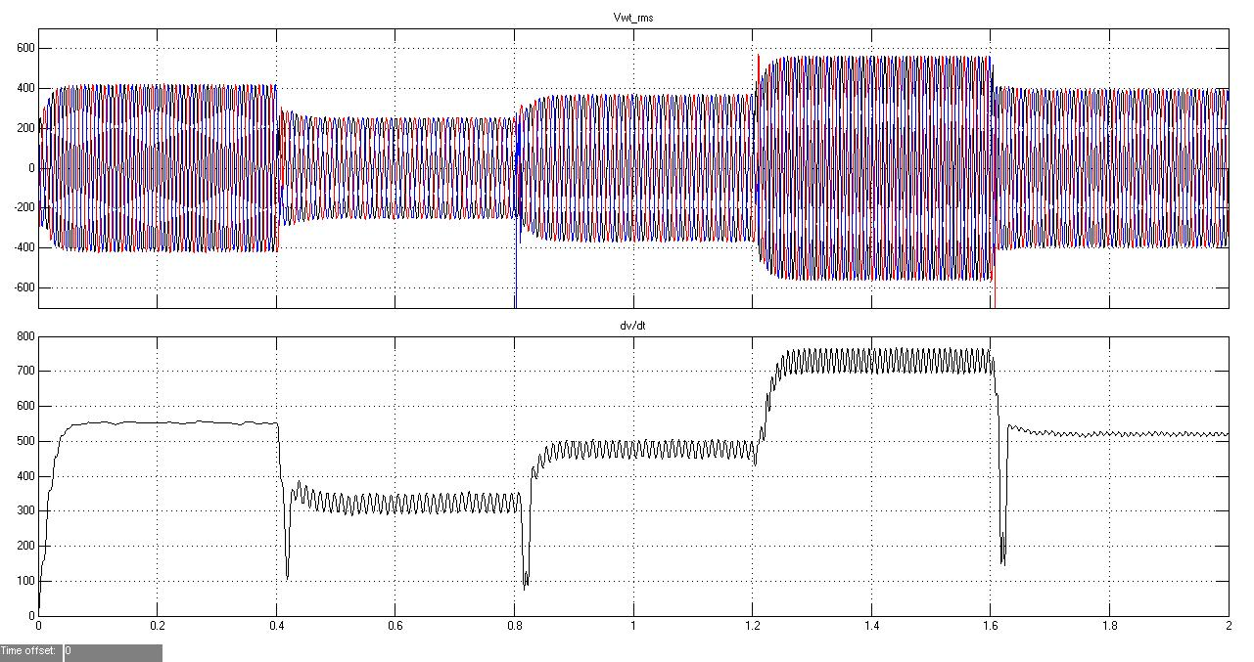
TEKNOLOJİ FAKÜLTESİ
ELEKTRİK ELEKTRONİK MÜHENDİSLİĞİ BÖLÜMÜ
Makale Başlığı
Öğrenci Adı, Danışman Adı
Author/s affiliation: e-mail, department, name of organization, city, country
I- Giriş
  There are several generator emulator and simulation experiments have been published in order to implement a useful basis for electromechanical control of wind turbines in literature.
  The squirrel-cage induction generators (SCIG) are used in both fixed and variable speed wind turbine applications due to their low costs, robustness and easy control features.
  In this paper, the proposed control schemes are based on converter control instead of generator in a variable speed wind turbine system as diverting the previous studies. The modeled system contains four main parts as variable voltage-variable frequency generator wind turbine model, 6-pulse sinusoidal pulse width modulation (SPWM) controlled rectifier, 3-level SPWM controlled multilevel inverter, and fuzzy logic controller model.
  The output voltage and frequency values of generator are set to 350-700V and 40-60Hz in order to simulate variable wind speeds. The fuzzy logic controller (FLC) is intended to define the most proper switching angles by adjusting modulation index (mi) ratio of inverter. The control algorithm of FLC is dependent to input voltage and frequency values of converter and tracks the output parameter mi according to changes of generator parameters.
II. Önerilen Yöntem
III. Benzetim/Uygulama Sonuçları
  The variable voltage variable frequency (VVVF) model has been constituted with three-phase programmable voltage sources in order to generate the desired variable input value of converter in Simulink.
  The fuzzy control block has been designed to control mi value of inverter according to ΔV and Δf of SCIG.
  The minimum voltage level has been set to 350V while the peak value was 700V.
  The three-phase variable voltage with variable frequency obtained at the output of SCIG model is illustrated in Fig. 2.d
  The generated voltage and frequency values of generator were 500V/45Hz, 350V/42Hz, 470V/47Hz, 700V/57Hz, 500V/49Hz.
  The output current increases to 55.6A without fuzzy control while it is decreased to 25A with FLC algorithm.
  The THD ratio of line currents has been measured as 3.25% during 2 kHz switching and 0.03% at 5 kHz switching frequency.
Poster 70x110 cm boyutlarında ve Türkçe hazırlanmalıdır
  Figure 3. The output currents of AC-DC-AC converter with fuzzy logic control
  Figure 1. Block diagram of the proposed multilevel converter
  The fuzzy controller is based on a Mamdani Fuzzy system that requires two input variables (V, f) (Fig. 2.a-b) to control output variable (mi), (Fig. 2.c) .
  The input and output variables have seven membership functions named as VVL (very very low), VL (very low), L (low), M (medium), H (high), VH (very high), and VVH (very very high).
  Figure 3. The THD analyzes of converter current, (a) 2 kHz switching frequency, (b) 5 kHz switching frequency
IV. Değerlendirme
  In this paper, the fuzzy logic control of an AC-DC-AC converter in a variable speed wind turbine system has been modeled using Matlab/Simulink in high accuracy.
  A fuzzy logic controller from input to output of system was designed and implemented to keep output current stable automatically and effectively under various input conditions.
  The FLC algorithm has been prepared obtaining required modulation index at 50V/2Hz increment of input from 350V/40Hz to 700V/60Hz.
  Although the simulation parameters were differing from measured voltage and frequency conditions, the implemented FLC algorithm was able to calculate the accurate modulation indexes.
(a) (b) (c)
(d)
  Figure 2. Fuzzy membership functions (a,b,c) and VVVF output of variable speed wind turbine model in Simulink

