Slide 1
GAZİ UNIVERSITY
TECHNOLOGY FACULTY
DEPARTMENT OF CIVIL ENGINEERING

Slide 2
İLETİŞİM
Adres : Gazi University Beşevler Campus
06500 Teknikokullar/ANKARA
Telefon : +90 312 202 88 60
Belgegeçer : +90 312 202 88 63
E-posta : teknolojiinsaatmuhendisligi@gazi.edu.tr

Slide 3
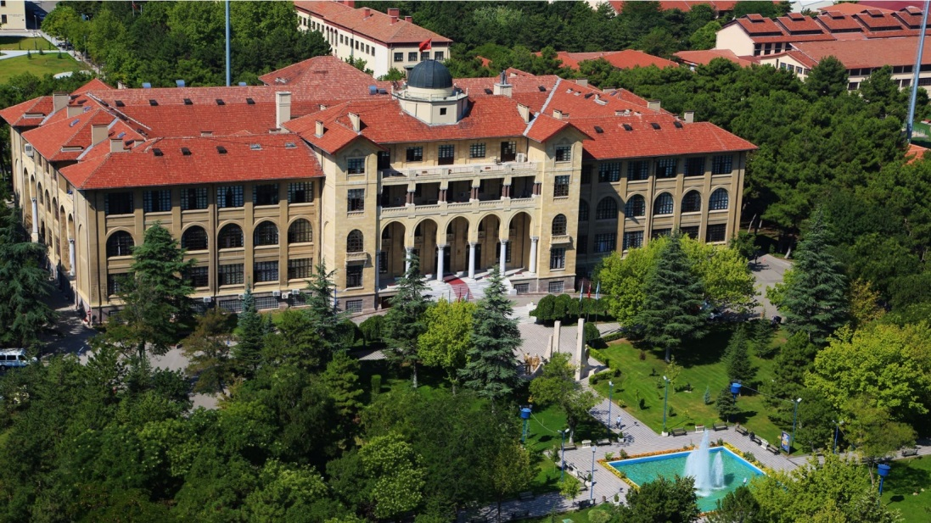
GAZİ UNIVERSITY

Slide 4
GAZİ UNIVERSITY
Gazi University, whose foundations were laid in 1926 with the instructions of Gazi Mustafa Kemal Atatürk, was opened with the name of Middle School Martial and Training Institute
Its name was changed as "Gazi Secondary School and Education Institute" in 1929
In 1976 it was named "Gazi Education Institute"
In 1982 it gained the identity of "Gazi University"

Slide 5
FACULTY OF TECHNOLOGY
With the decision of the Council of Ministers published in the Official Gazette dated 13 11 2009 and numbered 27405, Faculty of Technology was established.
In our faculty, which was established as a result of this decision, students were accepted to nine engineering programs in the 2010 2011 academic year.

Slide 6
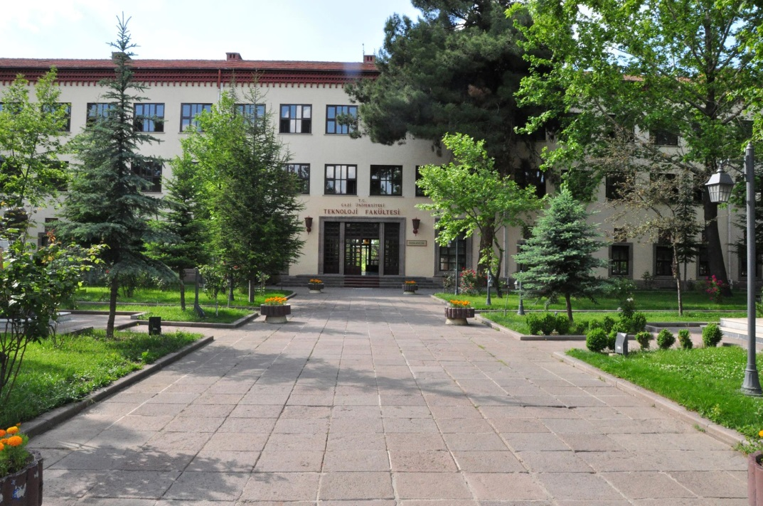
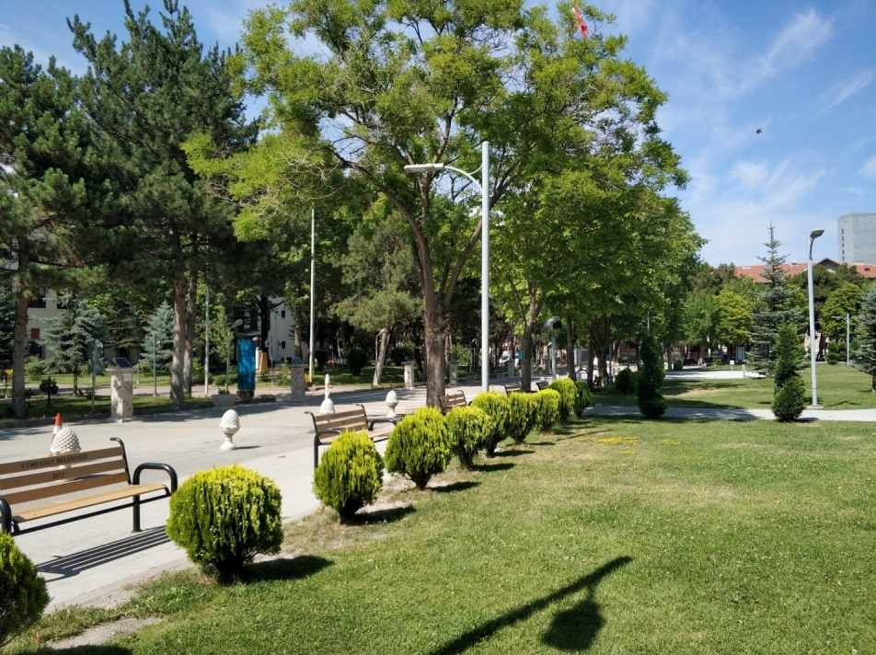
FACULTY OF TECHNOLOGY

Slide 7
TECHNOLOGY FACULTY DEPARTMENTS
1. Department of Wood Products Industrial Engineering
2. Department of Computer Engineering
3. Department of Electrical Electronic Engineering
4. Department of Industrial Design Engineering
5. Department of Energy Systems Engineering
6. Department of Manufacturing Engineering
7. Department of Civil Engineering
8. Department of Metallurgical and Materials Engineering
9.Department of Automotive Engineering

Slide 8
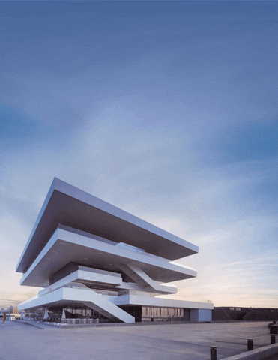
DEPARTMENT OF CIVIL ENGINEERING
In addition to the basic courses required by the engineering discipline, the curriculum of the Department of Civil Engineering includes the practical applications required by the construction industry.
In one of the 7th and 8th semesters, our students will spend one semester in a working environment in order to receive "Workplace Training" Thus, our graduates of Civil Engineering Department will be trained as civil engineers who have both theoretical and practical knowledge.

Slide 9
DEPARTMENT OF CIVIL ENGINEERING
İNŞAAT MÜHENDİSLİĞİ BÖLÜMÜ
Üniversite | 2010 | 2011 | 2012 | 2013 | 2014 | 2015 | 2016 | 2017 | 2018 | 2019
GAZİ ÜNİVERSİTESİ | 470.603 | 452.186 | 434,341 | 399,792 | 387,901 | 387,900 | 413,254 | 402.411 | 416,019 | 397,997
SAKARYA ÜNİVERSİTESİ | 426.960 | 419.119 | 387,005 | 358,603 | 350,496 | 350,496 | 371,347 | 362.208 | 354,175 | 319,658
SÜLEYMAN DEMİREL ÜNİVERSİTESİ | - | - | - | 329,404 | 324,979 | 324,979 | 371,523 | 340.951 | 313,927 | 289,385
DÜZCE ÜNİVESİTESİ | - | - | 366,051 | 335,980 | 332,941 | 326,455 | 367,829 | 325.810 | 326,232 | 292,184
FIRAT ÜNİVERSİTESİ | - | - | 356,022 | 328,086 | 311,506 | 309,277 | 325,647 | 312.825 | 295,837 | 281,410
KARADENİZ TEKNİK ÜNİV. | - | 395.757 | 358,976 | 348,614 | 342,876 | 342,876 | 368,404 | - | 371,800 | 340,400

Slide 10

In our department,
There are
•538 undergraduate
•124 graduate students.
91 students continue their education activities
in the Master's program and 33 students on the
Doctorate program.

Slide 11
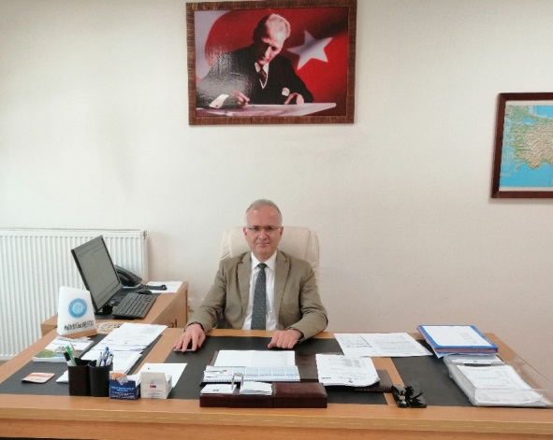
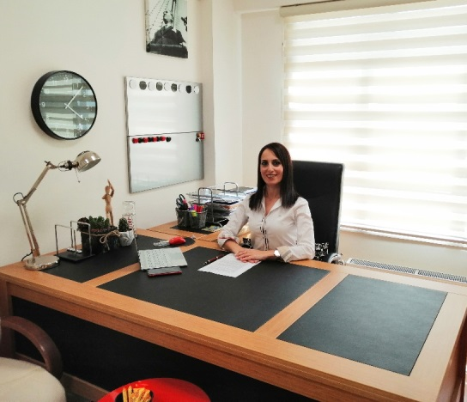
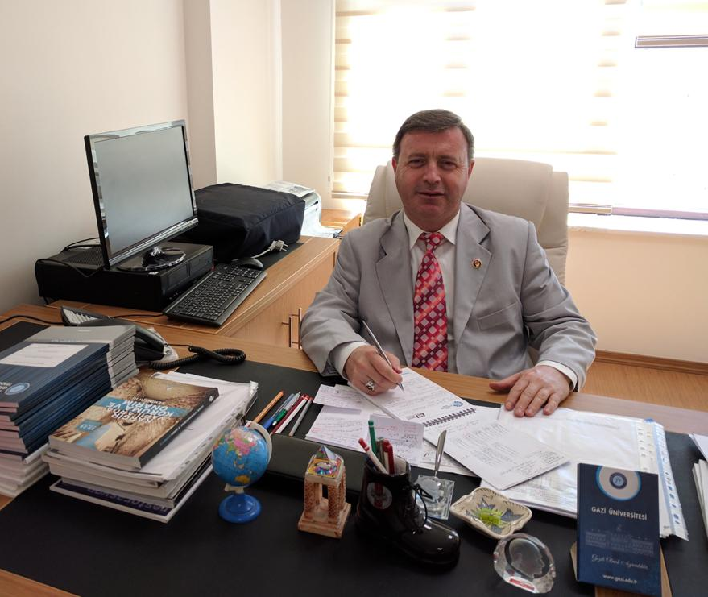
Administration of the Department
Prof. Dr. Hüseyin Yılmaz ARUNTAŞ
Chairperson
Assoc. Prof. Dr.
Arzuhan Burcu GÜLTEKİN
Vice Chairperson
Asst. Prof. Dr.
Ahmet GÖKDEMİR
Vice Chairperson

Slide 12
In our department
• 8 Professors,
• 4 Associate Professors,
• 4 Assistant Professors,
• 2 Lecturer,
• 9 Research Assistants,
There are total of 27 academic staff.

Slide 13
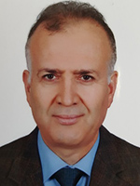
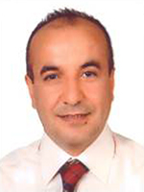
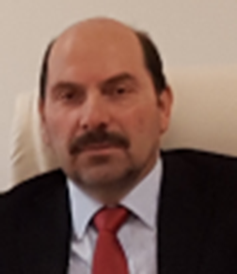
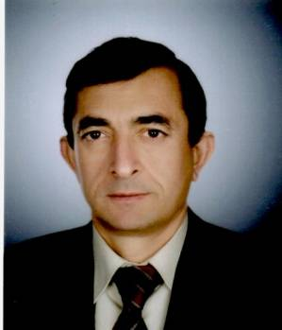
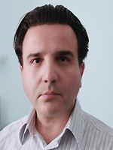
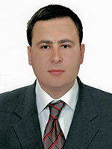
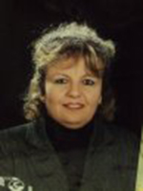
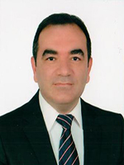
Faculty Members
Prof. Dr.
Mehmet ORHAN
Prof. Dr.
H. Yılmaz ARUNTAŞ
Prof. Dr.
Seyhan FIRAT
Prof. Dr.
Salih YAZICIOĞLU
Prof. Dr.
Nihat Sinan IŞIK
Prof. Dr.
Mürsel ERDAL
Prof. Dr.
Zeliha SELEK
Prof. Dr.
Alper BÜYÜKKARAGÖZ

Slide 14
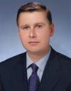
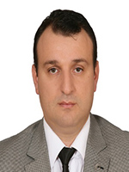
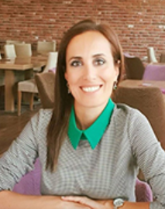
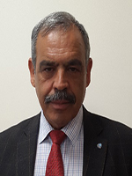
Faculty Members
Assoc. Prof. Dr.
Mustafa ÖZER
Assoc. Prof. Dr.
Gökhan DURMUŞ
Assoc. Prof. Dr.
Arzuhan Burcu GÜLTEKİN
Assoc. Prof. Dr.
Osman ŞİMŞEK

Slide 15
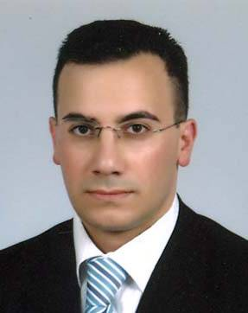
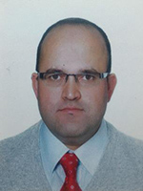
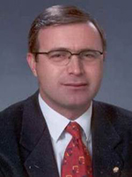
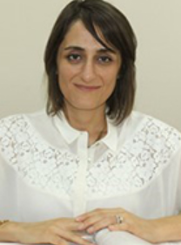
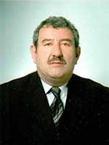
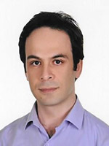
Faculty Members
Asst. Prof. Dr.
Yağmur KOPRAMAN
Asst. Prof. Dr.
Kürşat YILDIZ
Asst. Prof. Dr.
Ahmet GÖKDEMİR
Asst. Prof. Dr.
Eda AVANOĞLU SICACIK
Lecturer
Veysel EROLTEKİN
Lecturer
Ali Osman ATEŞ

Slide 16
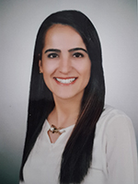
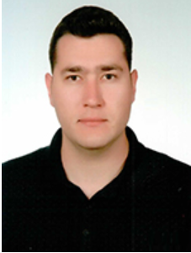
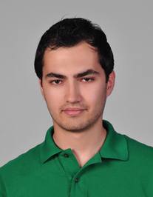
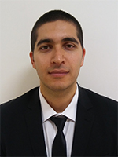
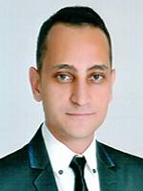
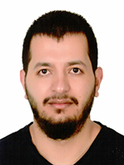
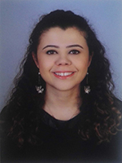
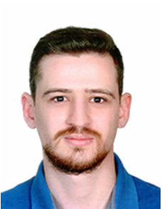
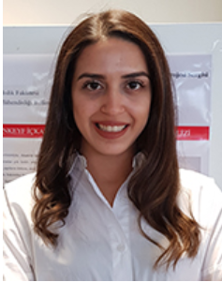
Faculty Members
Res. Asst. Dr.
Pınar Sezin
ÖZTÜRK KARDOĞAN
Res. Asst. Dr.
Murat PINARLIK
Res. Asst. Dr.
Anıl ÖZDEMİR
Res. Asst.
Coşkun ÇAKMAK
Res. Asst.
Mert ATAKAN
Res. Asst.
Ahmet ERDAĞ
Res. Asst.
Damla Nur ÇELİK
Res. Asst.
Özgün BOZDOĞAN
Res. Asst.
Tuğba YILDIZLI

Slide 17
LABORATORIES
1. Soil Mechanics Laboratory
2. Structural Mechanics Laboratory
3. Construction Materials Laboratory
4. Concrete Laboratory
5. Pavement Laboratory
6. Hydraulics Laboratory
7. Surveying Laboratory
8. Computer Laboratory
9. Masonry Practices Laboratory
10. Wood Practices Laboratory
11. TUKDER (Brick Tile) Laboratory

Slide 18
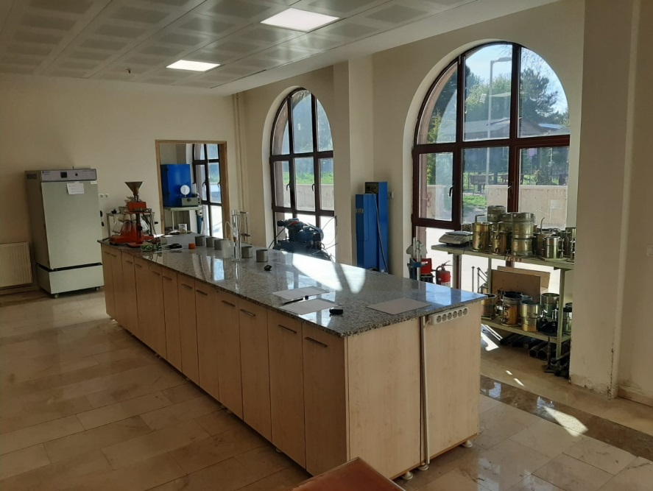
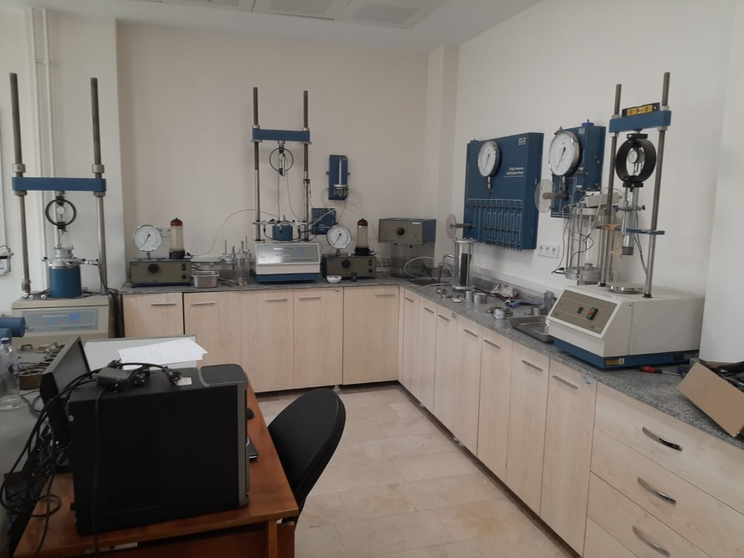
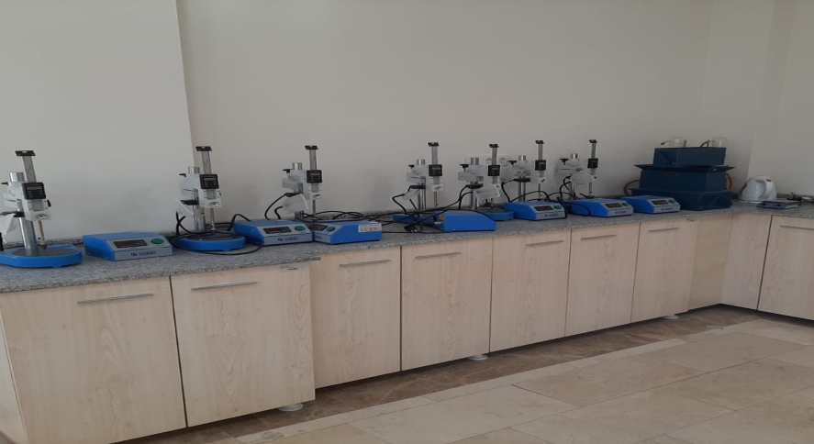
Soil Mechanics Laboratory
• Water content
• Granulometry
• Specific Weight
• Atterberg limits
• Proctor
• Porosity
• Consolidation Tests

Slide 19
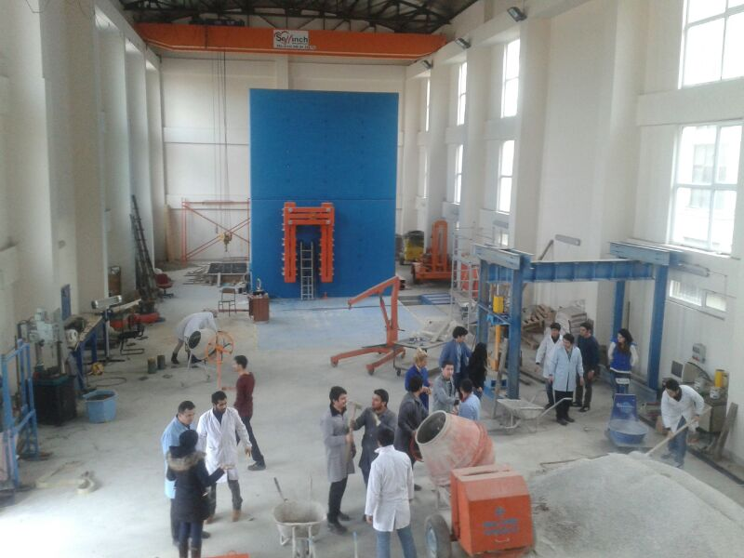
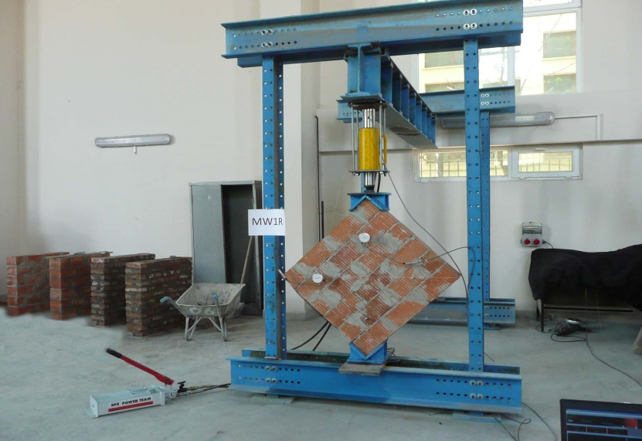
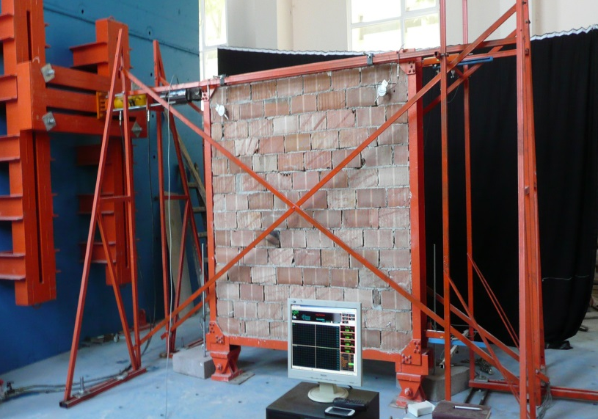
Structural Mechanics Laboratory
• Concrete Axial Compression and Steel Tensile Tests
• Strengthening / Repair of Construction Elements
• Comparison of Reinforced Concrete Building Designs
• Mechanical Tests of Building Elements such as Columns, Beams and Shear Walls
• Tests of Masonry Units

Slide 20
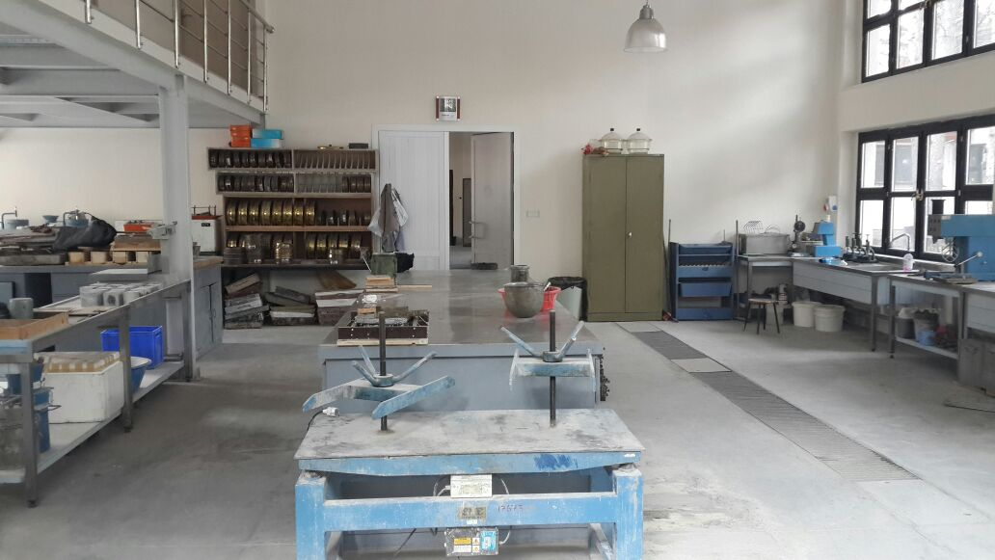
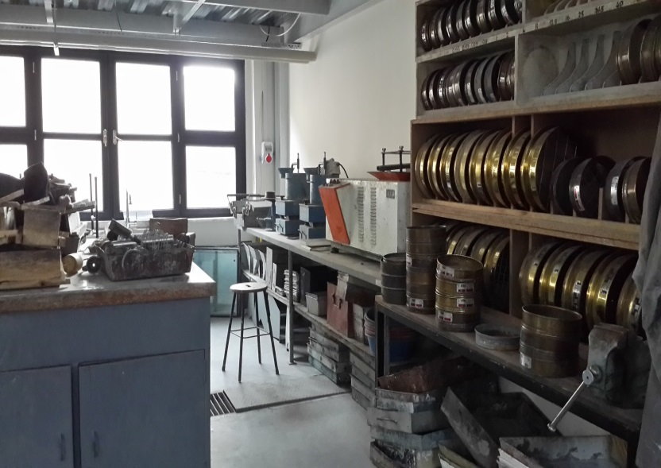
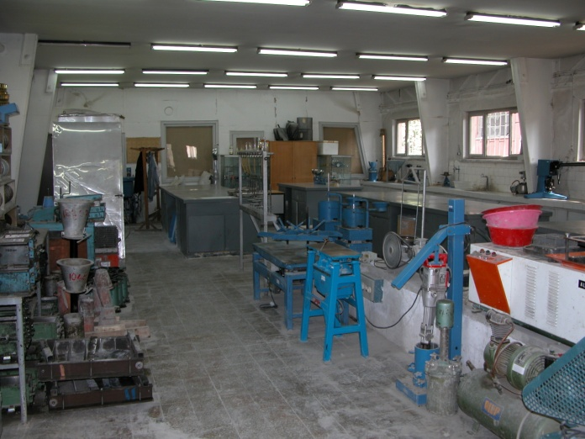
Construction Materials Laboratory
• Aggregate Tests
• Cement Tests
• Fresh Mortar Tests
• Concrete Mix Design
• Fresh Concrete Tests

Slide 21
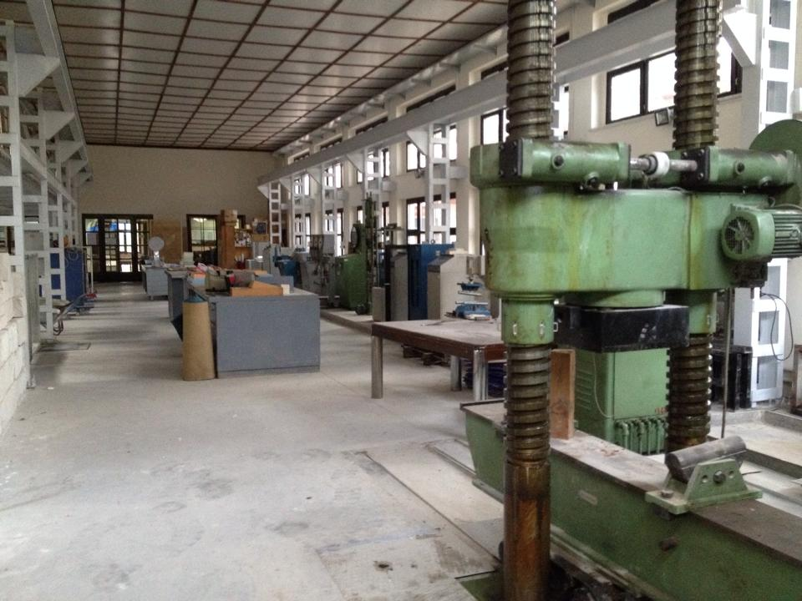
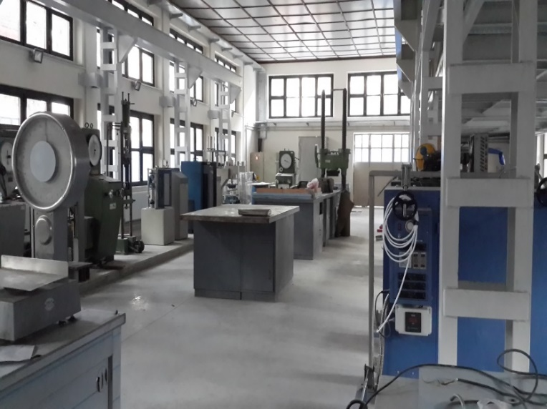
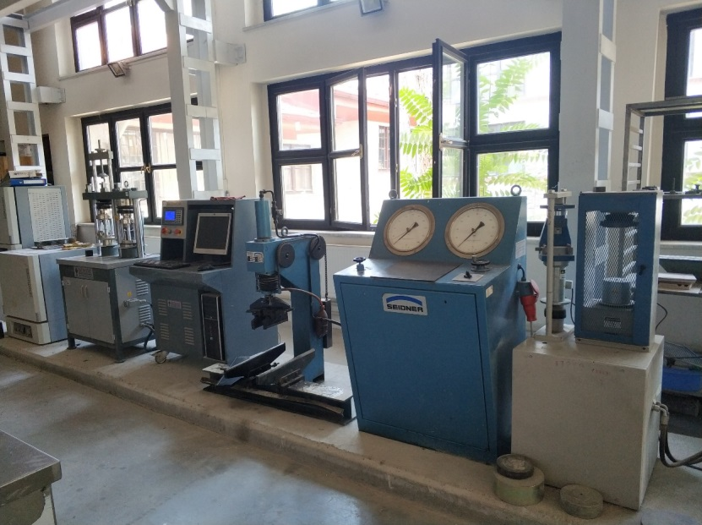
Concrete Laboratory
• Hardened Mortar Tests
• Hardened Concrete Tests
• Brick Tile Strength Tests
• Aerated Concrete Strength Tests
• Wood and Steel Strength Tests

Slide 22
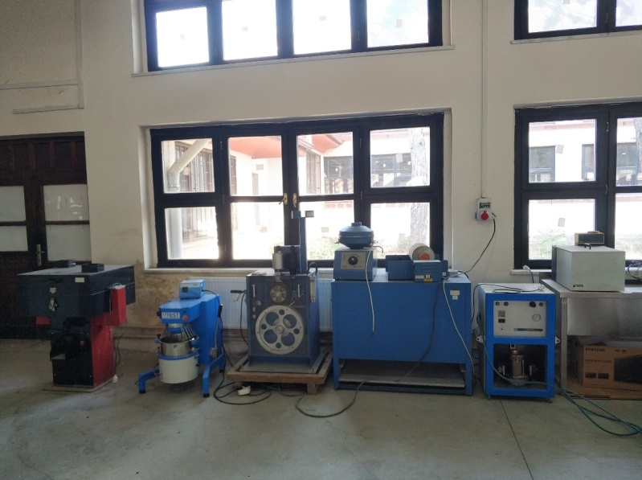
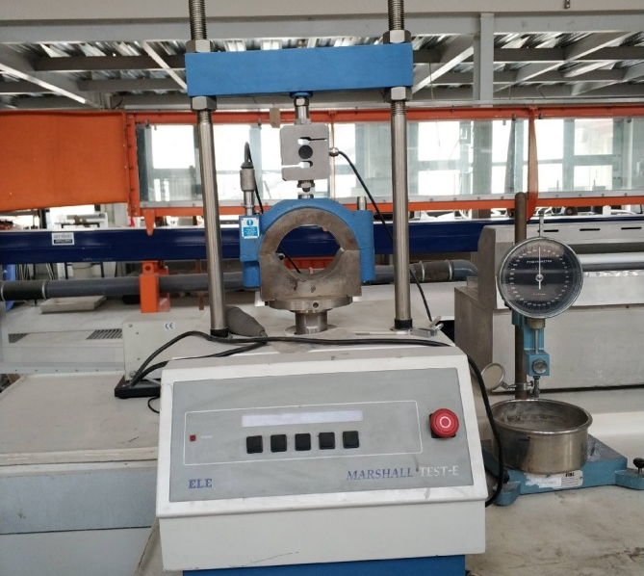
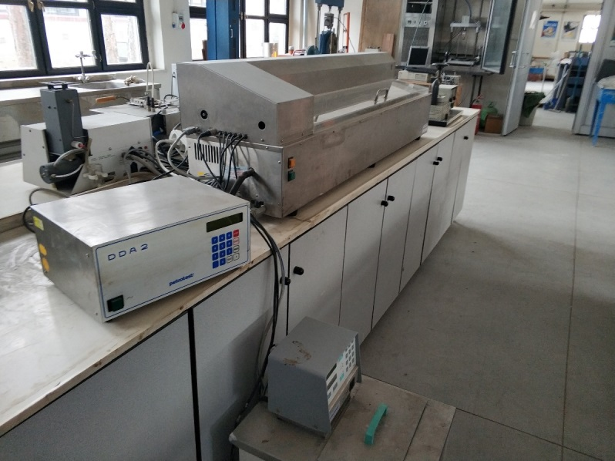
Pavement Laboratory
• Marshall Stability Test
• Penetration Test
• Ductility Test
• Softening point Test
• Flash Point Test
• Determination of bitumen ratio

Slide 23
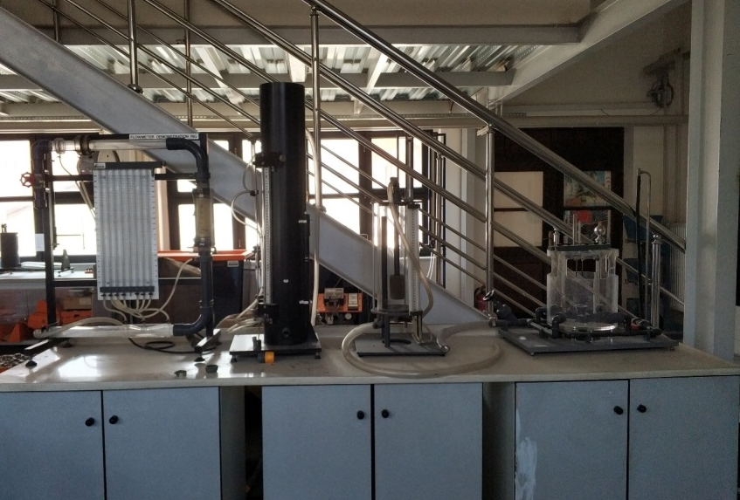


Hydraulics Laboratory
• Velocity Distributions in Open Channel Flows
• Reynolds Test
• Vortex Test

Slide 24


Computer Laboratory

Slide 25



Masonry Practices Laboratory
• Walling
• Plastering
• Insulation
• Ceramic Coating
• Reinforcement practices

Slide 26



Wood Practices Laboratory
• Formwork
• Roof
• Door Window
• Wooden construction elements

Slide 27

TUKDER ( Brick Tile ) Laboratory
TUKDER laboratory is a research and development (R&D) laboratory received through a grant from the Brick Tile Industrialists Association.
All kinds of brick and tile tests are carried out within the scope of the revolving fund in the laboratory.

Slide 28
DIVISIONS OF DEPARTMENT AND SUBJECTS WORKED
CONSTRUCTION MATERIALS DIVISION
Prof. Dr. Hüseyin Yılmaz ARUNTAŞ
Prof. Dr. Salih YAZICIOĞLU
Assoc. Prof. Dr. Osman ŞİMŞEK
Assoc. Prof. Dr. Gökhan DURMUŞ
Res. Asst.Damlanur ÇELİK
Subjects
Cemented Systems
Special Concretes
Repair Mortars and Special Mortars
Modern Construction Materials
Corrosion in Construction Materials
Mortars Used in Historical Buildings
Research on Insulation Applications

Slide 29
DIVISIONS OF DEPARTMENT AND SUBJECTS WORKED
STRUCTURAL MECHANICS DIVISION
Prof. Dr. Alper BÜYÜKKARAGÖZ
Asst. Prof. Dr. Yağmur KOPRAMAN
Asst. Prof. Dr. Eda AVANOĞLU SICACIK
Lecturer Ali Osman ATEŞ
Res. Asst. Dr. Anıl ÖZDEMİR
Res. Asst. Tuğba YILDIZLI
Subjects
Investigation of Earthquake Safety of Structures
Repair and Strengthening of Structures
Modeling with Finite Element Method
Behavior of Reinforced Concrete and Hybrid Building
Elements

Slide 30
DIVISIONS OF DEPARTMENT AND SUBJECTS WORKED
TRANSPORTATION DIVISION
Prof. Dr. Mehmet ORHAN
Asst. Prof. Dr. Kürşat YILDIZ
Res. Asst. Mert ATAKAN
Subjects
Highway / Railway Transport
Transportation / Logistics
Bituminous Hot Mixes
Transportation Planning

Slide 31
DIVISIONS OF DEPARTMENT AND SUBJECTS WORKED
GEOTECHNICS DIVISION
Prof. Dr. Mehmet ORHAN
Prof. Dr. Seyhan FIRAT
Prof. Dr. Nihat Sinan IŞIK
Assoc. Prof. Mustafa ÖZER
Res. Asst. Dr. P. Sezin ÖZTÜRK KARDOĞAN
Res. Asst. Ahmet ERDAĞ
Res. Asst. Özgün BOZDOĞAN
Subjects
Experimental Determination of Shear Strength and
Consolidation Parameters of Soils
Bearing Strength and Consolidation Settlement in Shallow
Foundations
Use of Geosynthetics in Reinforcement of Soils
Geotechnical Engineering Evaluations

Slide 32
DIVISIONS OF DEPARTMENT AND SUBJECTS WORKED
Subjects
Sustainable Buildings and Building Materials
Life Cycle Assessment in the Construction Sector
Energy and Water Conservation in Buildings
Green Buildings
Nearly Zero Energy Buildings
Construction Ergonomics
Restoration of Historical Buildings
BUILDING DESIGN AND RESTORATION DIVISION
Assoc. Prof. Arzuhan Burcu GÜLTEKİN
Asst. Prof. Dr. Ahmet GÖKDEMİR
Lecturer Veysel EROLTEKİN

Slide 33
DIVISIONS OF DEPARTMENT AND SUBJECTS WORKED
Subjects
Project and Construction Management
General Construction, Public Procurement and Zoning Legislation
Dispute Resolution Methods
Human Factor in Construction
Statistical Mathematics
Construction Contracts
Decision Support Systems in the Construction Sector
CONSTRUCTION MANAGEMENT DIVISION
Prof. Dr. Mürsel ERDAL
Arş. Gör. Coşkun ÇAKMAK

Slide 34
DIVISIONS OF DEPARTMENT AND SUBJECTS WORKED
Subjects
Flood Hydrology
Drought Analysis
Velocity Distributions in Open Channel Streams
Dam Operation
Integrated Water Resources Management
HYDRAULICS DIVISION
Prof. Dr. Zeliha SELEK
Res. Asst. Dr. Murat PINARLIK

Slide 35
PROJECTS COMPLETED/CONTINUE IN THE DEPARTMENT
•Erasmus+ / KA2 Cooperation for Innovation and the Exchange of Good Practices / KA205
Strategic Partnerships, “ Creating an Awareness on Zero Energy Buildings among Youngsters
(2020)
•Self Healing Asphalt Pavement Design
Asst . Prof. Dr. Kürşat YILDIZ,
• Experimental Investigation of Concrete Steel Adhesion Interface Under Concentric / Eccentric Tensile Effect
Asst. Prof. Dr. Yağmur KOPRAMAN , 2019
•Experimental Investigation of the Repair Potential of Damaged Shear Walls with Openings
Asst . Prof. Dr. Yağmur KOPRAMAN,

Slide 36
BÖLÜMDE TAMAMLANMIŞ / DEVAM EDEN PROJELER
• Investigation of Reinforced Concrete Beams Which Has Insufficient Shear Performance
Repaired with Basalt Based FRP (BFRP) Strips
Asst . Prof. Dr. Yağmur KOPRAMAN,
• Investigation of Khorasan Mortars Used in Historical Buildings and Production of Khorasan Mortar
Prof. Dr. H. Yılmaz ARUNTAŞ, 2016.
• Obtaining Hydrological Cycle Parameters with Conceptual Hydrological Model
Assoc . Prof. Dr. Zeliha SELEK,
• Nano Modified Cement Based Repair Materials Containing High Volume Fly Ash
Assoc . Prof. Dr. Osman ŞİMŞEK,

Slide 37
BÖLÜMDE TAMAMLANMIŞ / DEVAM EDEN PROJELER
• Shear Nailed Plate Application Method in Reinforced Concrete Column Beam Joints
Assoc . Prof. Dr. Alper BÜYÜKKARAGÖZ,
• Earthquake Behavior of Tunnel Formwork Units with Different Shear Wall Patterns
Prof. Dr. Recep KANIT , 2014
• Investigation of the Development of Macro Void Structure in Different Cement Mortars
Exposed to Sulphate Effect Using Computed Tomography Method
Prof. Dr. H. Yılmaz ARUNTAŞ, 2011.
• Investigation of Appropriate Improvement Methods for Increasing the Resistance of Soils
to Liquefaction in Areas with Liquefaction Potential in Manisa Saruhanlı District
Prof. Dr. Mehmet ORHAN, 2010

Slide 38
BÖLÜMDE TAMAMLANMIŞ / DEVAM EDEN PROJELER
•Leonardo da Vinci Lifelong Learning Program 2007 2013 Mobility Project , Investigation of Life Cycle Assessment Method within the Context of Environmental Effects of Building Materials ", Center for European Union Education and Youth Programs (National Agency),
European Commission , Gültekin, A. B., 2009.
• Specialised Ecvet Tr aining of Caregivers for People with Cerebral Palsy
Prof. Dr. Seyhan FIRAT, 2016.
• Training Entrepreneurs in Connecting Generations and Supporting Successful Business Succession Planning for micro SME
Prof. Dr. Seyhan FIRAT, 2014.
• M CARE: Mobile Training for Home and Health Caregiver For People with Disabilities and Older People
Prof. Dr. Seyhan FIRAT, 2013.

Slide 39
SCIENTIFIC ACTIVITIES IN OUR DEPARTMENT
(2010-2020 YEARS)
Symposiums
•ISBS 2019 IV. International Sustainable Building Symposium , USA / Texas Dallas, July 2019.
• ISBS 2017 III. International Sustainable Building Symposium , United Arab Emirates / Dubai, March 2017.
• ISBS 2015 II. International Sustainable Buildings Symposium , Gazi University / Ankara, May 2015.
• ISBS 2010 International Sustainable Building Symposium , Gazi University / Ankara, May 2010.
• International Conference and Exhibition on Application of Efficient and Renewable Energy Technologies in Low Cost Building Design and Construction, RENEWBUILD September , 2013

Slide 40
SCIENTIFIC ACTIVITIES IN OUR DEPARTMENT
(2010-2020 YEARS)
Workshops
• III. International on Earthquake and Sustainable Materials Workshop , Anadolu University, 24 June 2014
• II. International Workshop on Earthquake and Sustainable Materials Workshop , Gazi
University , 23 January 2013
• Sustainable Building s Workshop , Ramada Plaza, Ankara, 27 May 2010. ( International

Slide 41
SCIENTIFIC ACTIVITIES IN OUR DEPARTMENT
(2010-2020 YEARS)
Conferences
• Aerated Concrete Products and Environment Friendly Structures (GÜB ), Gazi University Technology Faculty Civil Engineering Department , Ankara, 19 March 2012. (National)
• Ceramic Products and Ceramic Tile Coating Seminar (Çanakkale Seramik Kaleseramik Education Foundation), Gazi University Technology Faculty Civil Engineering Department , Ankara, 29 March 2012. (National)
• Energy in Buildings Conference, 2012
• Brick Applications , TUKDER Brick and Tile Industrialists Association ), Gazi University , Ankara, 07 December 2011.
• Energy Architecture Conference (Çelik Erengezgin ), Gazi University Technology Faculty Civil
Engineering Department , Ankara, 20 October 2011. (National)
• Energy Efficiency in Buildings Conference (Murat Bayram), Gazi University Technology Faculty Civil Engineering Department , Ankara, 01 December 2011. (National)

Slide 42

ISBS 2019 IV. INTERNATIONAL SUSTAINABLE BUILDINGS SYMPOSIUM
(Dallas, Texas USA, July 2019)

Slide 43

ISBS 2017 II. INTERNATIONAL SUSTAINABLE BUILDINGS SYMPOSIUM (Dubai, UAE, March 2017)

Slide 44

ISBS 2015 INTERNATIONAL SUSTAINABLE BUILDINGS SYMPOSIUM
(Ankara, Turkey, May 2015)

Slide 45

ISBS 2010, THE INTERNATIONAL SUSTAINABLE BUILDINGS SYMPOSIUM
(Ankara, Turkey, May 2015)

Slide 46

ISBS 2010, THE INTERNATIONAL SUSTAINABLE BUILDINGS SYMPOSIUM
(Ankara, Turkey, May 2015)

Slide 47

ENERGY ARCHITECTURE CONFERENCE

Slide 48

CONFERENCE OF ENERGY IN BUILDINGS

Slide 49

BUSINESS LIFE AND INTERVIEW CONFERENCE

Slide 50

FROM ZERO TO HERO EU PROJECT DISSEMINATION MEETING
(MARCH 2020)

Slide 51
SOME OF THE TECHNICAL TRIPS
• MARMARAY PROJECT TECHNICAL VISIT
• KARABÜK STEEL FACTORY TECHNICAL VISIT
• ANKARA METRO TECHNICAL VISIT
• HISTORICAL BEYPAZARI HOUSES TECHNICAL VISIT
• ÇANAKKALE CERAMIC FACTORY TECHNICAL VISIT
• BURSA EPDM FACTORY TECHNICAL VISIT
• 3rd AIRPORT SITE TECHNICAL VISIT
• SAMSUN TRABZON RIZE TECHNICAL AND SOCIAL TRIP (BAFRA ALTINKAYA DAM)
• TECHNICAL TOUR OF THE 3rd BOSPHORUS BRIDGE AND THE GULF CROSSING BRIDGE
• KEÇİÖREN METRO TECHNICAL VISIT

Slide 52

MARMARAY PROJECT TECHNICAL VISIT

Slide 53

MARMARAY PROJECT TECHNICAL VISIT

Slide 54

MARMARAY PROJECT TECHNICAL VISIT

Slide 55

BURSA EPDM (MEMBRANE) FACTORY TECHNICAL VISIT

Slide 56

IGA 3rd AIRPORT TECHNICAL VISIT

Slide 57

ÇANAKKALE CERAMIC FACTORY TECHNICAL VISIT

Slide 58

KEÇİÖREN METRO TECHNICAL VISIT

Slide 59

SAMSUN-TRABZON RIZE TECHNICAL AND SOCIAL TRIP
(BAFRA ALTINKAYA)

Slide 60

ARTVİN DERİNER DAM TECHNICAL VISIT

Slide 61

İNŞAAT MÜHENDİSLİĞİ BÖLÜMÜ
Student clubs are actively operating in our department and social activities continue. We expect your participation. Clubs are listed below
1. Faculty of Technology Construction Club,
2. Technology Faculty Idealist Engineers Club
3. Gazi University Young Green Crescent Club

Slide 62

FACULTY SOCIAL FACILITIES

Slide 63

FACULTY SOCIAL FACILITIES

Slide 64

FACULTY SOCIAL FACILITIES

Slide 65

CONTACT
For the curriculum and course contents of the Civil Engineering Department and important announcements
www.tf insaat.gazi.edu.tr
For technical visits and organizations of the Civil Engineering Department
www.topluluklar.gazi.edu.tr

