Slide 1

CHE 392
CHEMICAL ENGINEERING LAB I
DATA ANALYSIS
Prof. Dr. N. Alper TAPAN
Dr. D. Dolunay ESLEK KOYUNCU
Dr. H. Mehmet TAŞDEMİR

Slide 2
OUTLINE
SIGNIFICANT FIGURES IN EXPERIMENTAL DATA
STATISTICAL ANALYSIS OF EXPERIMENTAL DATA
TYPES OF ERRORS
DEGREE OF FREEDOM, CONFIDENCE INTERVAL
REFERENCES

Slide 3
SIGNIFICANT FIGURES
Significant figures are digits showing a numerical value with proper accuracy and precision.
For instance ,The number of significant figures in 4521 and 6,784 are 4.
The number of significant figures in 0,006784 and 4521000 are also 4 . The number of zeros before 6 or after 1 are not related with precision .

Slide 4
Some rules about significant figures
The number of significant figures in 4521000. are 7 because the dot (.) shows that the precision will change by the number following the dot (.)
Rounding of numbers and change in significant figures;
52.6502 →52.7, 3.457 → 3.46 , 0.34648 → 0.346
73.135 → 73.14 , 48.724 → 48.72

Slide 5
OPERATIONS IN SIGNIFICANT FIGURES
Addition and subraction: The precision is based on lowest number of significant figures.
32.7 +3.62+10.008=46.328 →
46.3
Significant figures 3
Significant figures 5
Significant figures 3
Multiplication and division: Like addition or subraction , the result is rounded based on the lowest number of significant figures.

Slide 6
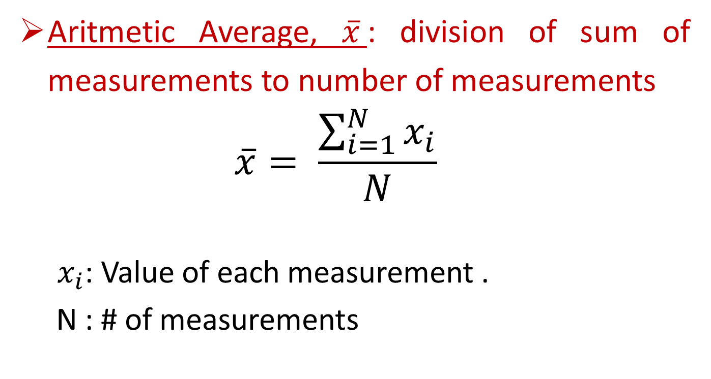
STATISTICAL ANALYSIS OF EXPERIMENTAL DATA
Some important statistical terms;
Aritmetic Average, $\overline{x}$: division of sum of measurements to number of measurements
  $$\overline{x}= \frac{\sum_{i=1}^{N}{x_{i}}}{N}$$
  $x_{i}$: Value of each measurement .
N : # of measurements

Slide 7
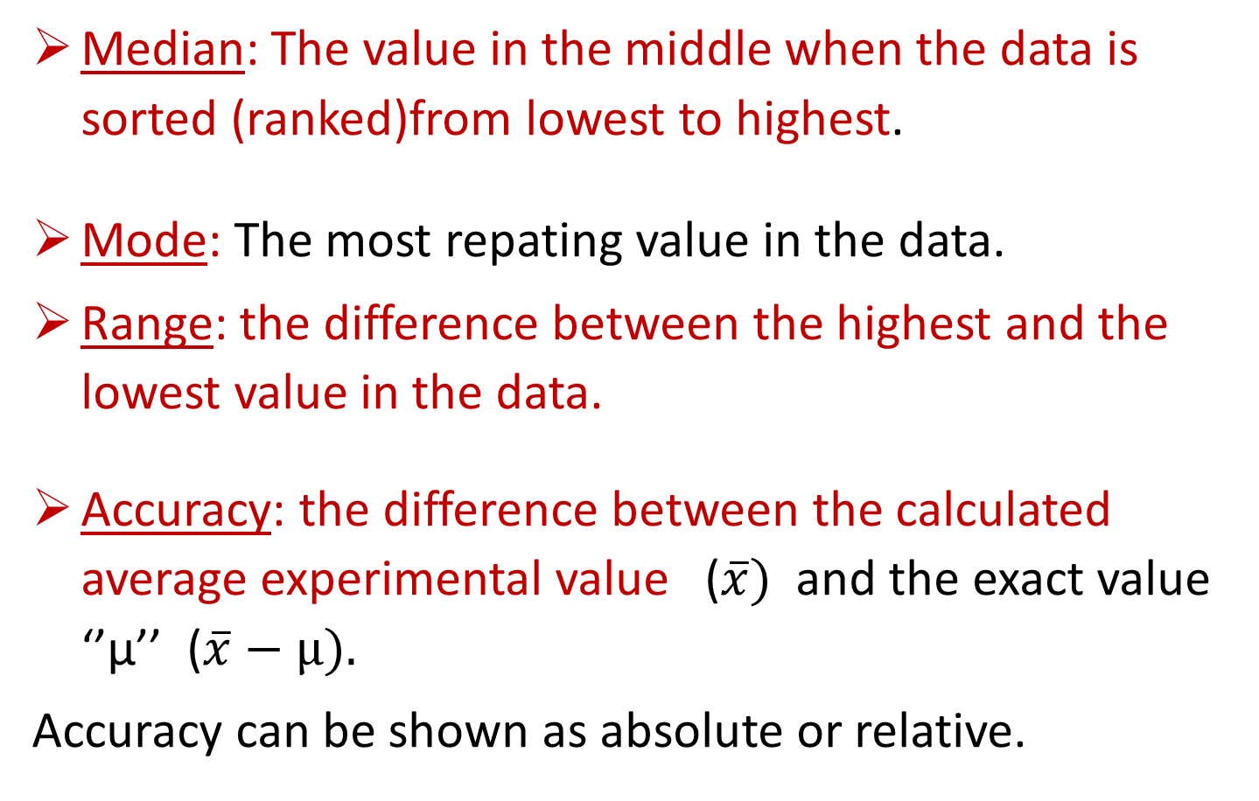
STATISTICAL ANALYSIS OF EXPERIMENTAL DATA
Median: The value in the middle when the data is sorted (ranked)from lowest to highest.
Mode: The most repating value in the data.
Range: the difference between the highest and the lowest value in the data.
Accuracy: the difference between the calculated average experimental value ($\overline{x})$ and the exact value ‘’µ’’ ($\overline{x}−µ).$
Accuracy can be shown as absolute or relative.

Slide 8
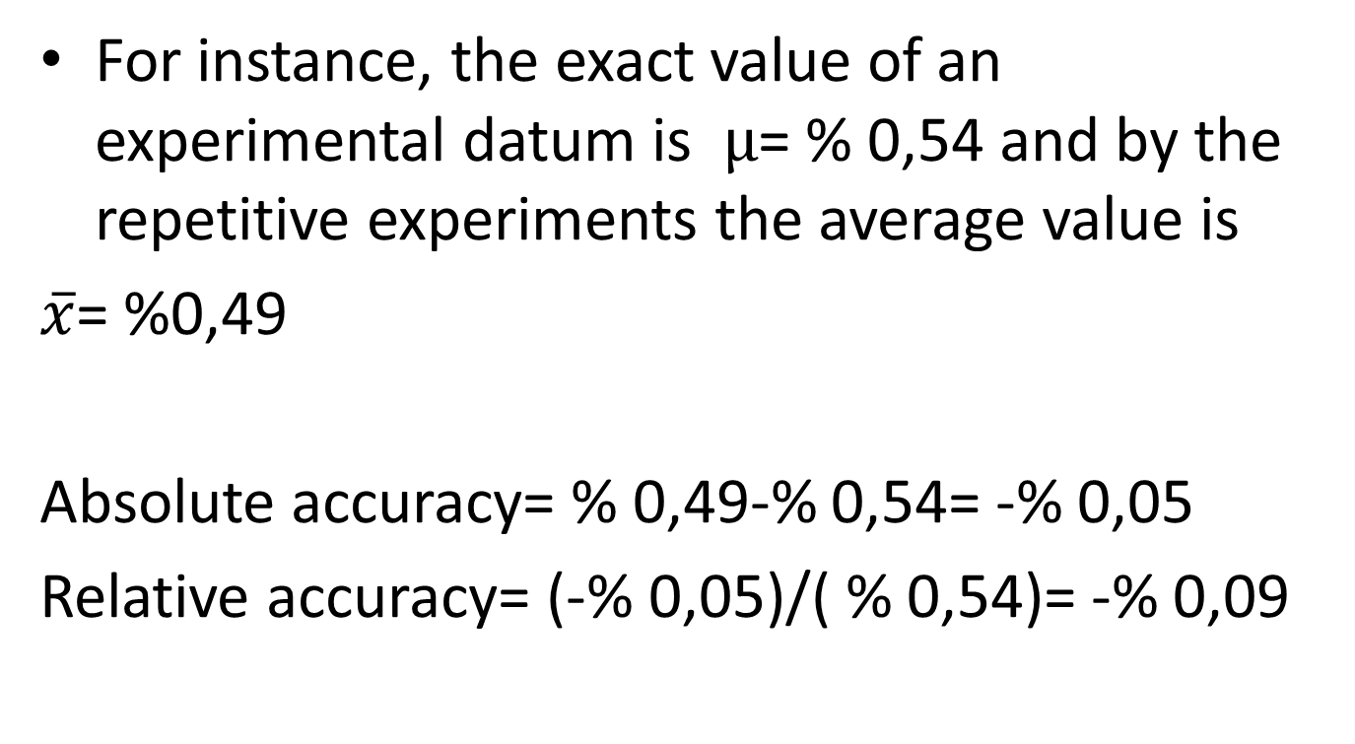
STATISTICAL ANALYSIS OF EXPERIMENTAL DATA
For instance, the exact value of an experimental datum is $µ$= % 0,54 and by the repetitive experiments the average value is
$\overline{x}$= %0,49
Absolute accuracy= % 0,49-% 0,54= -% 0,05
Relative accuracy= (-% 0,05)/( % 0,54)= -% 0,09

Slide 9
STATISTICAL ANALYSIS OF EXPERIMENTAL DATA
Certainity: The proximity of the experimental values; Certainity can be determined by;
Standard deviation
Relative standard deviation
Variance
Range
Error
Average error
Relative average error

Slide 10
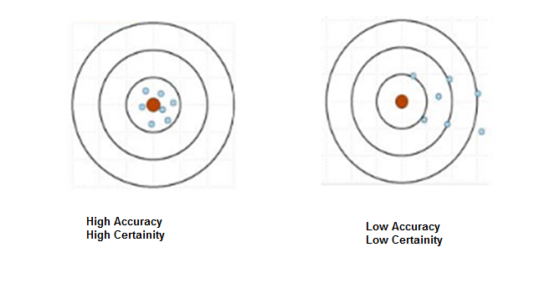

?
Accuracy = Certainity

Slide 11
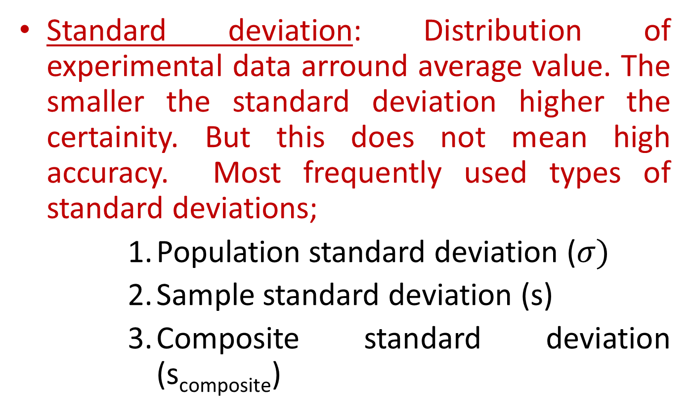
STATISTICAL ANALYSIS OF EXPERIMENTAL DATA
Standard deviation: Distribution of experimental data arround average value. The smaller the standard deviation higher the certainity. But this does not mean high accuracy. Most frequently used types of standard deviations;
Population standard deviation ($σ)$
Sample standard deviation (s)
Composite standard deviation (s_{composite})

Slide 12
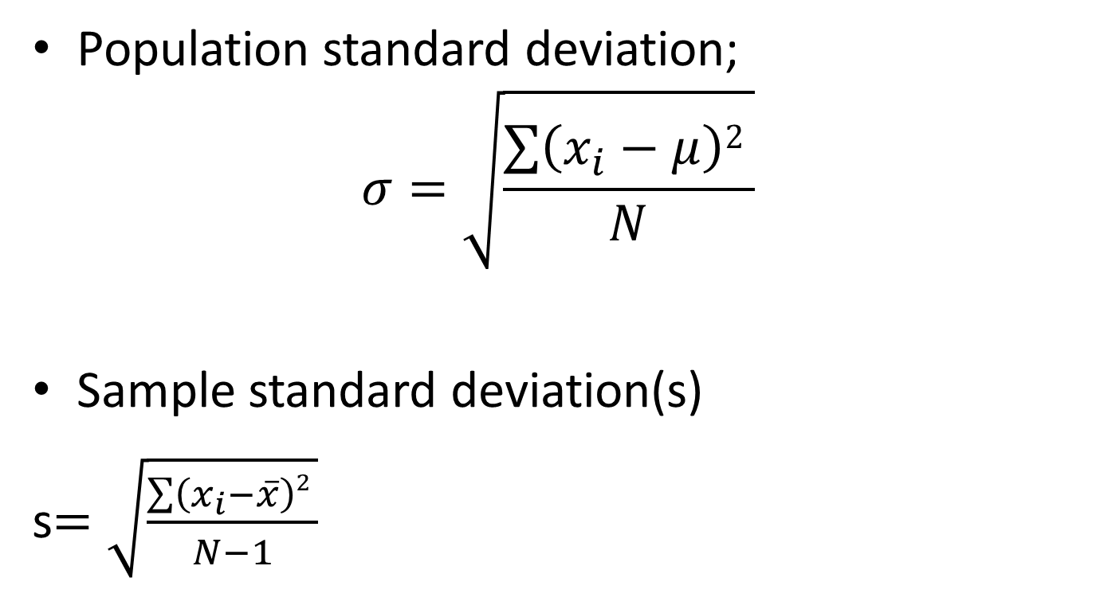
STATISTICAL ANALYSIS OF EXPERIMENTAL DATA
Population standard deviation;
$$σ=\sqrt{\frac{\sum{\left(x_{i}−μ\right)2 }}{N}}$$
Sample standard deviation(s)
s$=\sqrt{\frac{\sum{\left(x_{i}−\overline{x}\right)2 }}{N−1}}$

Slide 13
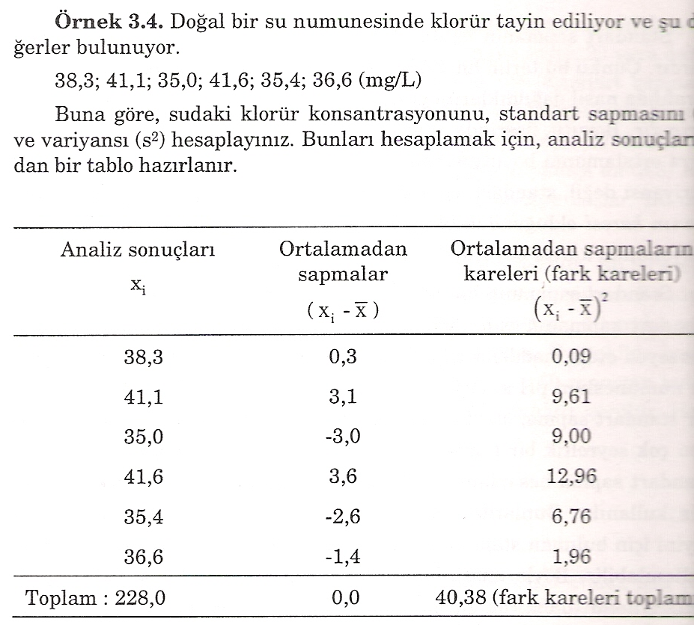

Slide 14
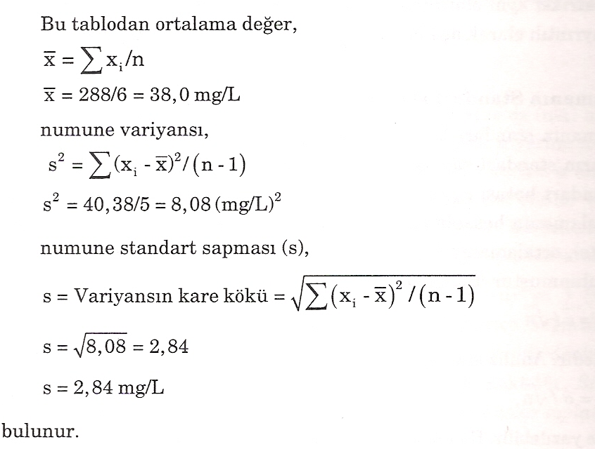

Slide 15
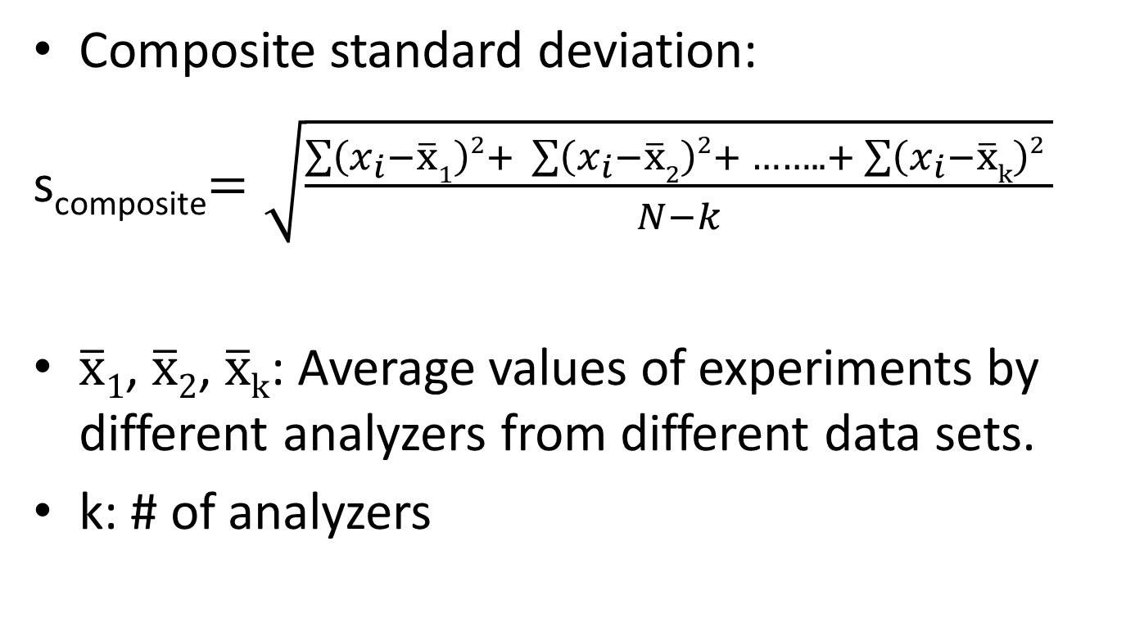
STATISTICAL ANALYSIS OF EXPERIMENTAL DATA
Composite standard deviation:
s_{composite}$=\sqrt{\frac{\sum{\left(x_{i}−\overline{x}1\right)2+ }\sum{\left(x_{i}−\overline{x}2\right)2+ ……..+\sum{\left(x_{i}−\overline{x}k\right)2 }}}{N−k}}$
$\overline{x}1$, $\overline{x}2$, $\overline{x}k$: Average values of experiments by different analyzers from different data sets.
k: # of analyzers

Slide 16
STATISTICAL ANALYSIS OF EXPERIMENTAL DATA
Example:
After fishing , 5 samples of fishes were dried and analyzed by atomic absorbtion spectroscopy (AAS) for mercury determination. Based on this experimental data determine the composite standard deviation.

Slide 18
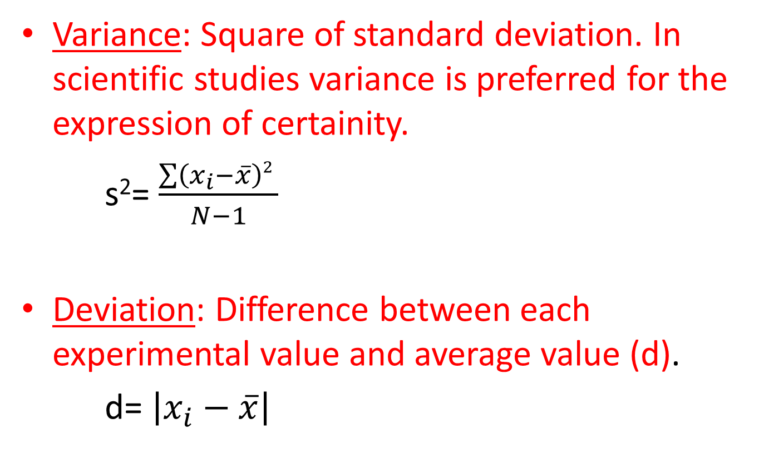
STATISTICAL ANALYSIS OF EXPERIMENTAL DATA
Variance: Square of standard deviation. In scientific studies variance is preferred for the expression of certainity.
s²= $\frac{\sum{\left(x_{i}−\overline{x}\right)2 }}{N−1}$
Deviation: Difference between each experimental value and average value (d).
d= $\left|x_{i}−\overline{x}\right|$

Slide 19
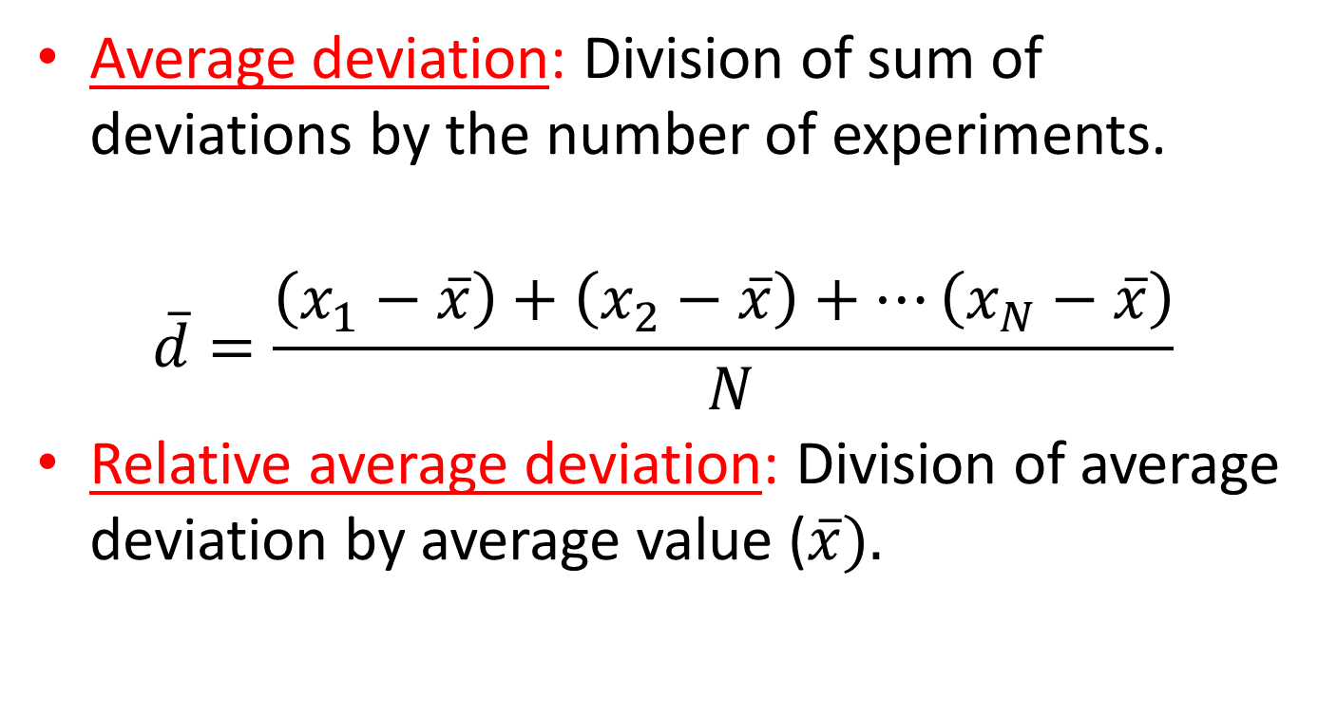
STATISTICAL ANALYSIS OF EXPERIMENTAL DATA
Average deviation: Division of sum of deviations by the number of experiments.
$$\overline{d}=\frac{\left(x_{1}−\overline{x}\right)+\left(x_{2}−\overline{x}\right)+…\left(x_{N}−\overline{x}\right)}{ N}$$
Relative average deviation: Division of average deviation by average value ($\overline{x}).$

Slide 20
TYPE OF ERRORS
Systematic errors (can be avoided)
Instrumental
Methodological
Personal
2. Random (can not be avoided)

Slide 21
SYSTEMATIC ERRORS
TYPE OF ERRORS
Instrumental errors;
Bad calibration of instruments and unstabilities on power sources.
For instance , during titration the real values may be different from the readings on the burette or graduated pipette, flasks.

Slide 22
RANDOM ERRORS
TYPE OF ERRORS
Errors that cannot be avoided.
Independent of the experience of the experimenter. Because of this, there are always some minor errors.
Random errors may be caused by experimenter or may be due to instrumentation or environmental conditions.
If we don’t know the exact value of error, we determine a range of experimental values by standard deviation or confidence interval.

Slide 23
SOURCES OF TYPE OF ERRORS
Non ideal chemical and physical behaviour of reactants or reactions during analysis cause errors.
Personnal errors are caused to the experimenter . For instance, inadequate washing of precipitate or false recording of data etc.

Slide 24
DEGREE OF FREEDOM, CONFIDENCE LIMITS AND INTERVALS
A confidence interval (CI) is a range of values that’s likely to include a population value with a certain degree of confidence. It is often expressed a % whereby a population means lies between an upper and lower interval.
A confidence interval, in statistics, refers to the probability that a population parameter will fall between two set values for a certain proportion of times. Confidence intervals measure the degree of uncertainty or certainty in a sampling method. A confidence interval can take any number of probabilities, with the most common being a 95% or 99% confidence level.
Confidence level refers to the percentage of probability, or certainty, that the confidence interval would contain the true population parameter when you draw a random sample many times.

Slide 25
DEGREE OF FREEDOM, CONFIDENCE LIMITS AND INTERVALS
Q test method can be used to discard or accept a suspected experimental value. In this method , different confidence levels can be used , Q test is based on the selected confidence level.

Slide 26
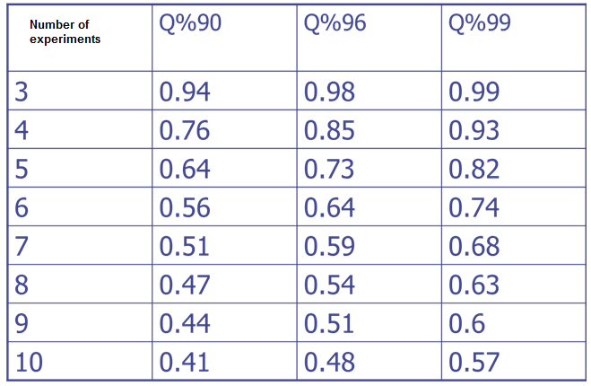
DEGREE OF FREEDOM, CONFIDENCE LIMITS AND INTERVALS
Table . Q values at different confidence levels

Slide 27
DEGREE OF FREEDOM, CONFIDENCE LIMITS AND INTERVALS
Example: For the data shown below:
12.53, 12.56 , 12.47 , 12.67 , 12.48 , is 12.67 OK for 90% confidence interval ?
12.47, 12.48 , 12.53, 12.56, ← difference = 0.11 → 12.67
Range= 0.20
Q = difference / range = 0.55 < Q_{(value} _{in} _{tablelo )} (keep the value)
If Q_{(observed)}> Q_{(value in the table)} value is thrown based on the confidence level given.

Slide 28
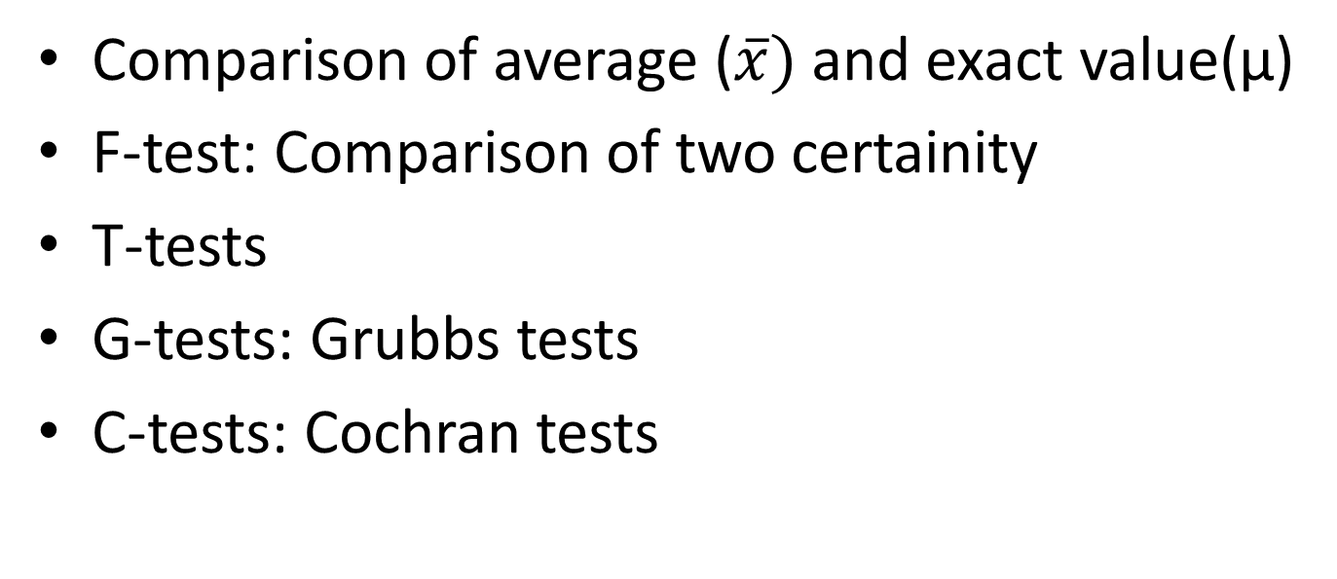
DEGREE OF FREEDOM, CONFIDENCE LIMITS AND INTERVALS
Some significance tests
Comparison of average ($\overline{x})$ and exact value(µ)
F-test: Comparison of two certainity
T-tests
G-tests: Grubbs tests
C-tests: Cochran tests

Slide 29
References
Harris, D.C., “Analytical Chemistry”, W.H. Freeman and Company, 42 , 1982.
Kreyzig, E., “Advanced Engineering Mathematics” , 8th edition, John Wiley and Sons Inc., 914 , 1999.
Bennett, C.A., Franklin, N.L., “Statistical Analysis in Chemistry and the Chemical Industry”, John Wiley and Sons Inc., 1967.
Mickley, H.S., Sherwood, T.K., and Reed, C.E., “Applied Mathematics in Chemical Engineering”, McGraw-Hill, 1957.
Reilly, P.M., “A Statistical Look at Significant Figures”, Chemical Engineering Education”, summer issue, 152-155,1992.
Schwatz, L.M., “Propagation of Significant Figures”, Journal of Chemical Engineering Education., 62(8) , 693 , 1985.
Garland, C.W., Nibler, J.W., “Experiments in Physical Chemistry” ,7th edition, McGraw-Hill, 2003
Usanmaz, A., “Quantitative Analytical Chemistry”, Middle East Technical University, 1991.
Gündüz, T., ‘’Kimyacılar için İstatistik’’, 2. Baskı, Gazi Kitap evi, 2010
Skoog, D.A., West, D.M., Holler, F.J., ‘’Analitik Kimya Temelleri’’, Editör: E.Kılıç, F. Köseoğlu, 7. Baskı, Bilim Yayıncılık, 1997.

