Slide 1
Your Name
Topic/Topics you will present like:
FACT FILE: The eyes of an ostrich are larger than its brain.

Slide 2
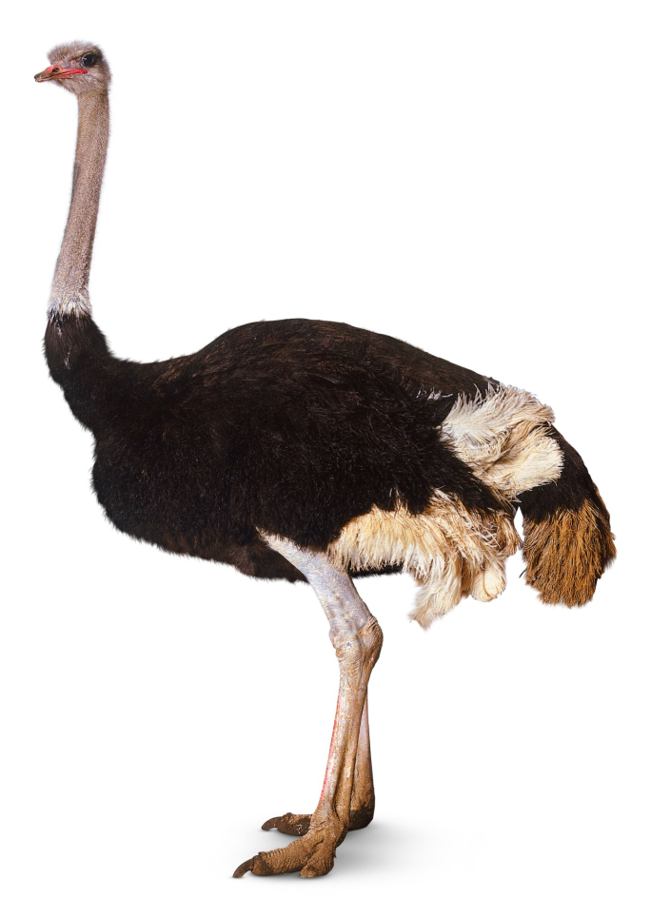
FACT FILE: The eyes of an ostrich are larger than its brain.
OSTRICH

Slide 3
Features of an ostrich
Largest bird! – up to 8ft tall
Eats grass, seeds, small insects!
Between 240-300 pounds!
Can live up to 40 years!
Lives mostly in Northern Africa!

Slide 4
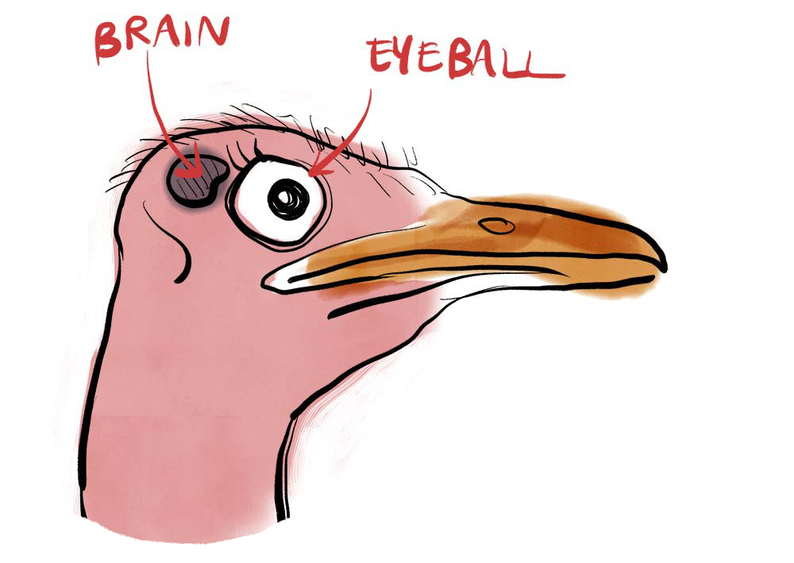
Its brain is tiny!

Slide 5
Dear Students,
Your presentation –of course- should be longer than this – this is just an example!
As you see, there are no full sentences on the slide! Just write keywords.
You can include photos.
You do not have to prepare lots of slides – we care about your talk more than your Misrosoft PowerPoint skills.

