Slide 1
Your Name
Topic/Topics you will present like:
FACT FILE: The eyes of an ostrich are larger than its brain.

Slide 2
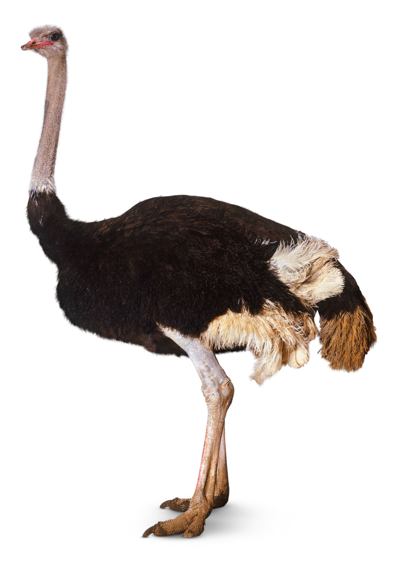
FACT FILE: The eyes of an ostrich are larger than its brain.
OSTRICH

Slide 3
Features of an ostrich
Largest bird! – up to 8ft tall
Eats grass, seeds, small insects!
Between 240-300 pounds!
Can live up to 40 years!
Lives mostly in Northern Africa!

Slide 4
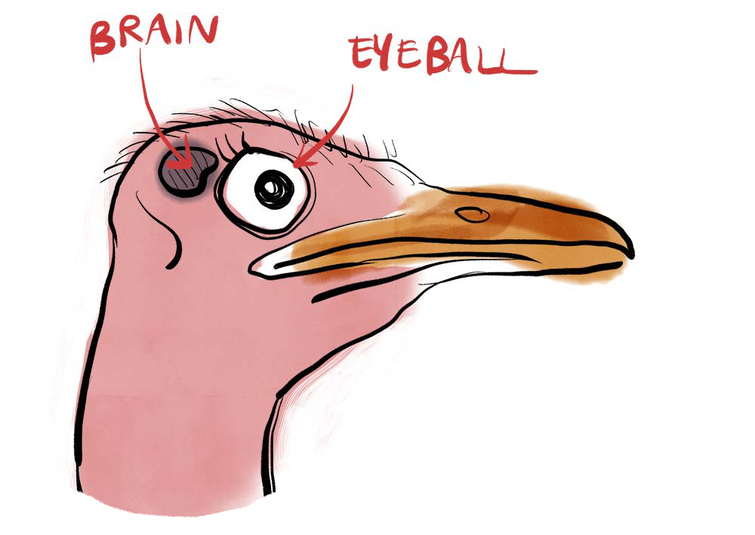
It’s brain is tiny!

Slide 5
Dear Students,
As you see, there are no full sentences on the slide! Just write keywords.
You can include photos.
You do not have to prepare lots of slides – we care about your talk more than your Misrosoft PowerPoint skills.

